Slide 1
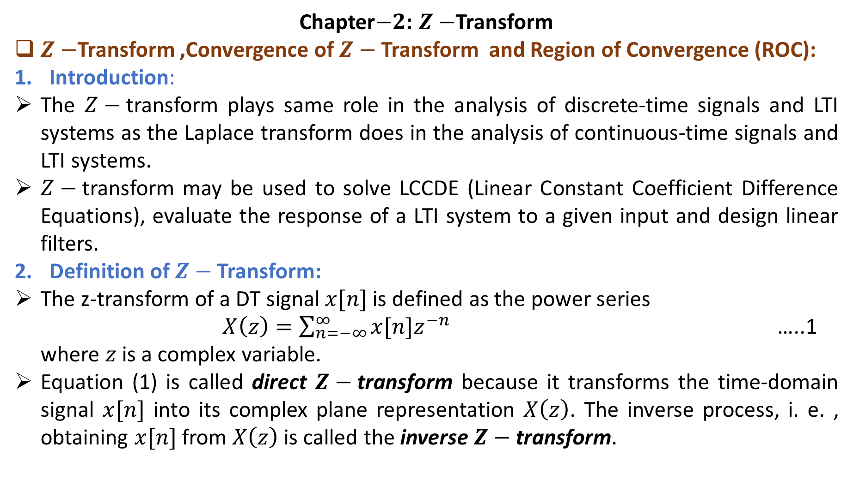
Chapter$−2$: $Z−$Transform
$Z−$Transform ,Convergence of $Z−$Transform and Region of Convergence (ROC):
Introduction:
The $Z−$transform plays same role in the analysis of discrete-time signals and LTI systems as the Laplace transform does in the analysis of continuous-time signals and LTI systems.
$Z−$transform may be used to solve LCCDE (Linear Constant Coefficient Difference Equations), evaluate the response of a LTI system to a given input and design linear filters.
Definition of $Z−$Transform:
The z-transform of a DT signal $x[n]$ is defined as the power series
$X\left(z\right)=\sum_{n=−∞}^{∞}{x[n]z^{−n}}$ …..1
where $z$ is a complex variable.
Equation (1) is called direct $Z−$transform because it transforms the time-domain signal $x[n]$ into its complex plane representation $X\left(z\right)$. The inverse process, i. e. , obtaining $x[n]$ from $X\left(z\right)$ is called the inverse $Z−$transform.

Slide 2
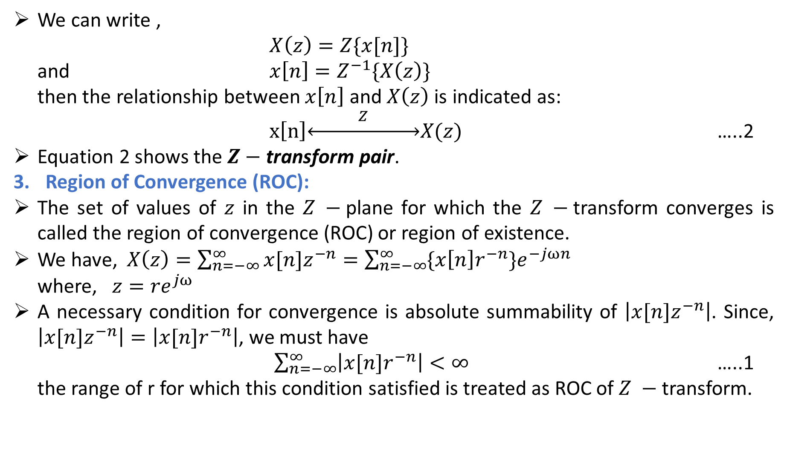
We can write ,
$X\left(z\right)=Z\{x[n]\}$
and $x\left[n\right]=Z^{−1}\{X\left(z\right)\}$
then the relationship between $x\left[n\right]$ and $X\left(z\right)$ is indicated as:
$x\left[n\right]\underset{↔}{ Z }X(z)$ …..2
Equation 2 shows the $Z−$transform pair.
Region of Convergence (ROC):
The set of values of $z$ in the $Z −$plane for which the $Z −$transform converges is called the region of convergence (ROC) or region of existence.
We have, $X\left(z\right)=\sum_{n=−∞}^{∞}{x[n]z^{−n}}=\sum_{n=−∞}^{∞}{\{x\left[n\right]r^{−n}\}e^{−jωn}}$
where, $z={re}^{jω}$
A necessary condition for convergence is absolute summability of $\left|x[n]z^{−n}\right|$. Since, $\left|x[n]z^{−n}\right|=\left|x[n]r^{−n}\right|$, we must have
$\sum_{n=−∞}^{∞}{\left|x[n]r^{−n}\right|}<∞$ …..1
the range of r for which this condition satisfied is treated as ROC of $Z −$transform.

Slide 3
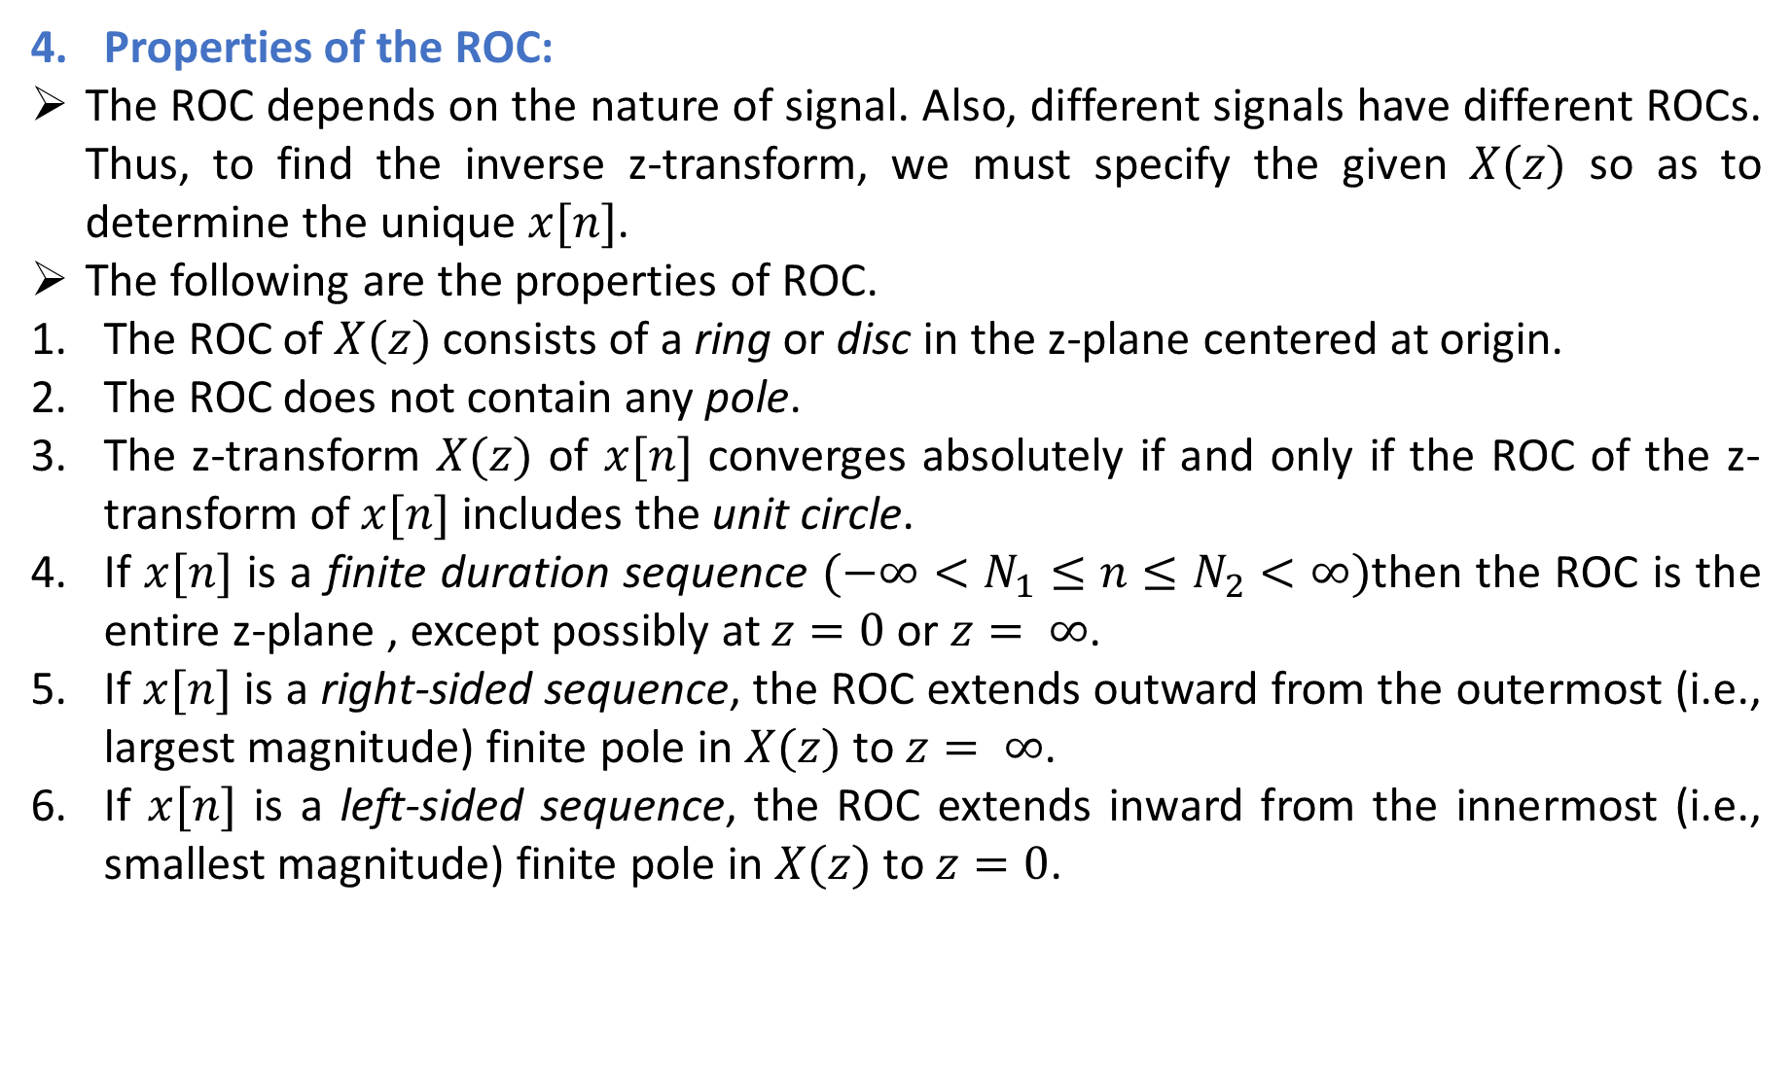
Properties of the ROC:
The ROC depends on the nature of signal. Also, different signals have different ROCs. Thus, to find the inverse z-transform, we must specify the given $X(z)$ so as to determine the unique $x[n]$.
The following are the properties of ROC.
The ROC of $X(z)$consists of a ring or disc in the z-plane centered at origin.
The ROC does not contain any pole.
The z-transform $X(z)$ of $x[n]$ converges absolutely if and only if the ROC of the z-transform of $x[n]$ includes the unit circle.
If $x[n]$ is a finite duration sequence $(−∞<N_{1}≤n≤N_{2}<∞)$then the ROC is the entire z-plane , except possibly at $z=0$ or $z= ∞$.
If $x[n]$ is a right-sided sequence, the ROC extends outward from the outermost (i.e., largest magnitude) finite pole in $X(z)$ to $z= ∞$.
If $x[n]$ is a left-sided sequence, the ROC extends inward from the innermost (i.e., smallest magnitude) finite pole in $X(z)$ to $z=0$.

Slide 4
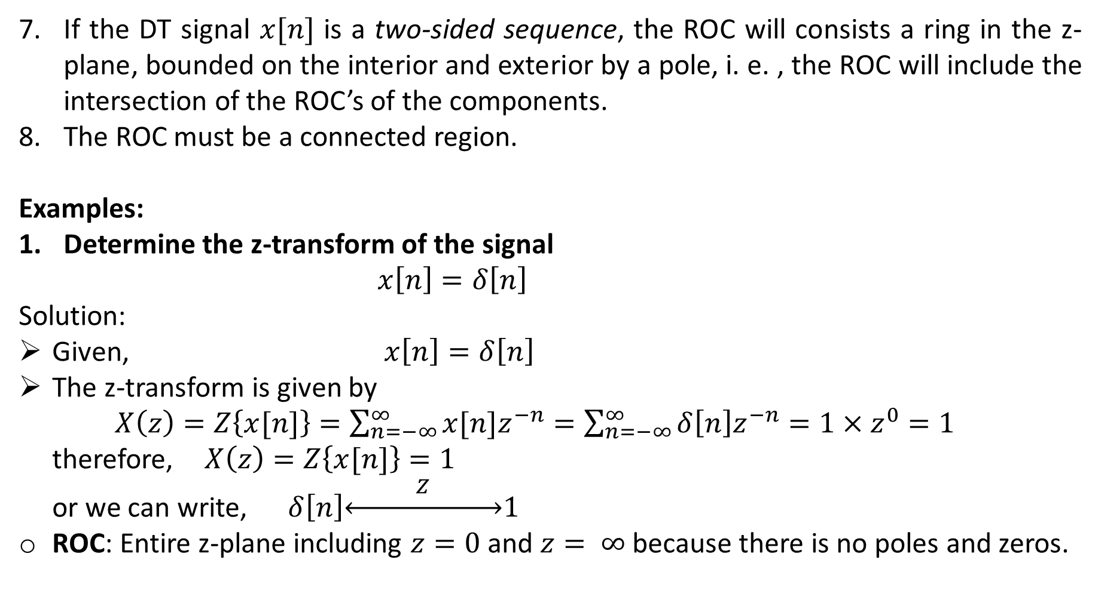
If the DT signal $x[n]$ is a two-sided sequence, the ROC will consists a ring in the z-plane, bounded on the interior and exterior by a pole, i. e. , the ROC will include the intersection of the ROC’s of the components.
The ROC must be a connected region.
Examples:
Determine the z-transform of the signal
$x\left[n\right]=δ\left[n\right]$
Solution:
Given, $x\left[n\right]=δ\left[n\right]$
The z-transform is given by
$X\left(z\right)=Z\left\{x[n]\right\}=\sum_{n=−∞}^{∞}{x[n]z^{−n}}=\sum_{n=−∞}^{∞}{δ\left[n\right]z^{−n}=1×z^{0}=1}$
therefore, $X\left(z\right)=Z\left\{x[n]\right\}=1$
or we can write, $δ\left[n\right]\underset{↔}{ Z }1$
ROC: Entire z-plane including $z=0$ and $z= ∞$ because there is no poles and zeros.

Slide 5
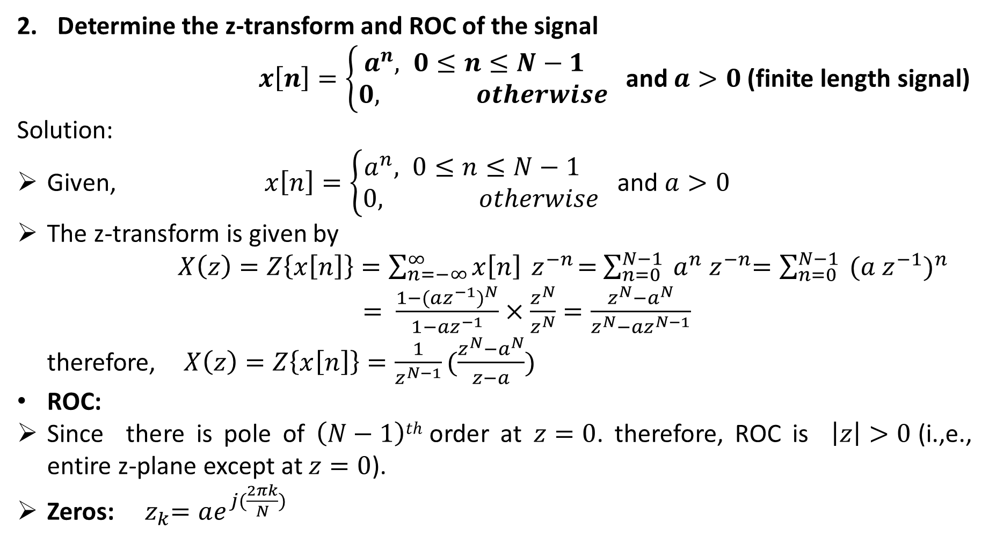
Determine the z-transform and ROC of the signal
$x\left[n\right]=\left\{\begin{aligned}a^{n}, 0≤n≤N−1 \\ 0, otherwise\end{aligned}\right.$ and $a>0$ (finite length signal)
Solution:
Given, $x\left[n\right]=\left\{\begin{aligned}a^{n}, 0≤n≤N−1 \\ 0, otherwise\end{aligned}\right.$ and $a>0$
The z-transform is given by
$X\left(z\right)=Z\left\{x\left[n\right]\right\}=\sum_{n=−∞}^{∞}{x\left[n\right]{ z}^{−n}=}$ $\sum_{n=0}^{N−1}{{ a}^{n}{ z}^{−n}=\sum_{n=0}^{N−1}{{ (a{ z}^{−1})}^{n} }}$
$= \frac{1−{(az^{−1})}^{N}}{1−az^{−1}}×\frac{z^{N}}{z^{N}}=\frac{z^{N}−a^{N}}{z^{N}−az^{N−1}}$
therefore, $X\left(z\right)=Z\left\{x\left[n\right]\right\}=\frac{1}{z^{N−1}}(\frac{z^{N}−a^{N}}{z−a})$
ROC:
Since there is pole of $\left(N−1\right)th$ order at $z=0$. therefore, ROC is $\left|z\right|>0$ (i.,e., entire z-plane except at $z=0$).
Zeros: ${ z}_{k}=ae^{j(\frac{2πk}{N})}$

Slide 6
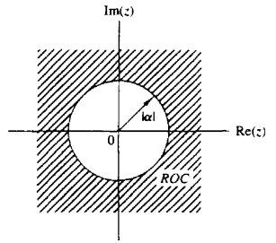
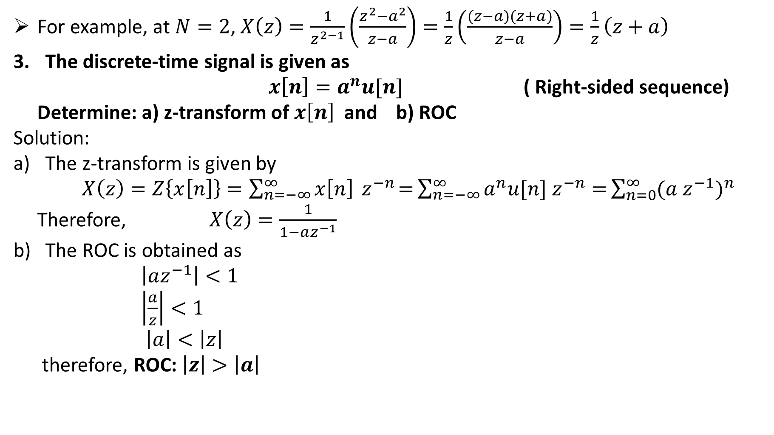
For example, at $N=2$, $X\left(z\right)=\frac{1}{z^{2−1}}\left(\frac{z^{2}−a^{2}}{z−a}\right)=\frac{1}{z}\left(\frac{(z−a)(z+a)}{z−a}\right)=\frac{1}{z}\left(z+a\right)$
The discrete-time signal is given as
$x\left[n\right]=a^{n}u[n]$ ( Right-sided sequence)
Determine: a) z-transform of $x\left[n\right]$ and b) ROC
Solution:
The z-transform is given by
$X\left(z\right)=Z\left\{x\left[n\right]\right\}=\sum_{n=−∞}^{∞}{x\left[n\right]{ z}^{−n}=}\sum_{n=−∞}^{∞}{a^{n}{u[n] z}^{−n}=}\sum_{n=0}^{∞}{{(a{ z}^{−1})}^{n}}$
Therefore, $X\left(z\right)=\frac{1}{1−az^{−1}}$
The ROC is obtained as
$\left|az^{−1}\right|<1$
$\left|\frac{a}{z}\right|<1$
$\left|a\right|<\left|z\right|$
therefore, ROC: $\left|z\right|>\left|a\right|$

Slide 7
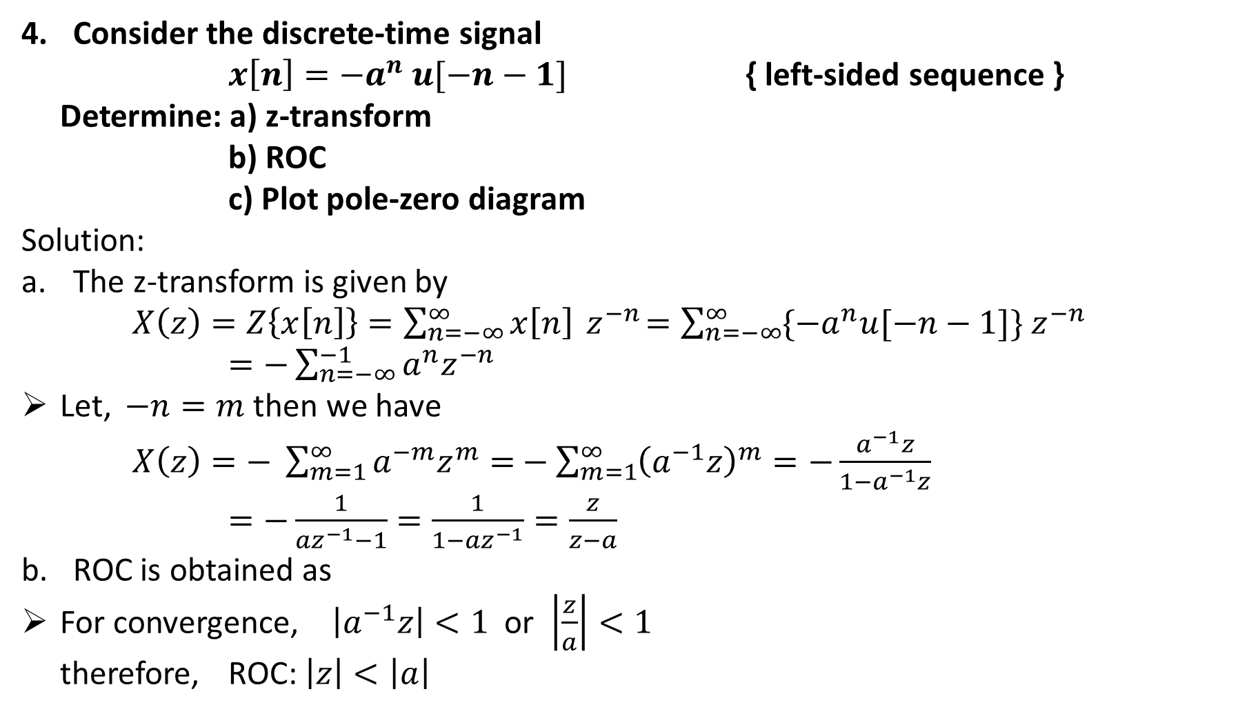
Consider the discrete-time signal
$x\left[n\right]=−a^{n} u[−n−1]$ { left-sided sequence }
Determine: a) z-transform
b) ROC
c) Plot pole-zero diagram
Solution:
The z-transform is given by
$X\left(z\right)=Z\left\{x\left[n\right]\right\}=\sum_{n=−∞}^{∞}{x\left[n\right]{ z}^{−n}=\sum_{n=−∞}^{∞}{\{−a^{n}u[−n−1]\}{ z}^{−n}}}$
$=−\sum_{n=−∞}^{−1}{a^{n}z^{−n}}$
Let, $−n=m$ then we have
$X\left(z\right)=− \sum_{m=1}^{∞}{a^{−m}z^{m}=}−\sum_{m=1}^{∞}{{\left(a^{−1}z\right)}^{m}=−\frac{a^{−1}z}{1−a^{−1}z}}$
$=−\frac{1}{{az}^{−1}−1}=\frac{1}{1−{az}^{−1}}=\frac{z}{z−a}$
ROC is obtained as
For convergence, $\left|a^{−1}z\right|<1$ or $\left|\frac{z}{a}\right|<1$
therefore, ROC: $\left|z\right|<\left|a\right|$

Slide 8
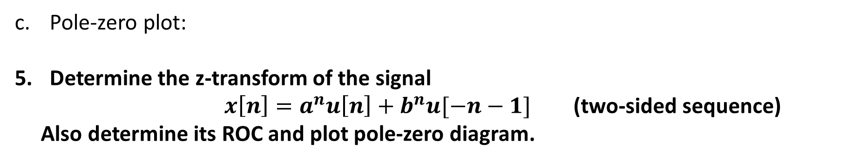
Pole-zero plot:
Determine the z-transform of the signal
$x\left[n\right]=a^{n}u\left[n\right]+b^{n}u[−n−1]$ (two-sided sequence)
Also determine its ROC and plot pole-zero diagram.

Slide 9
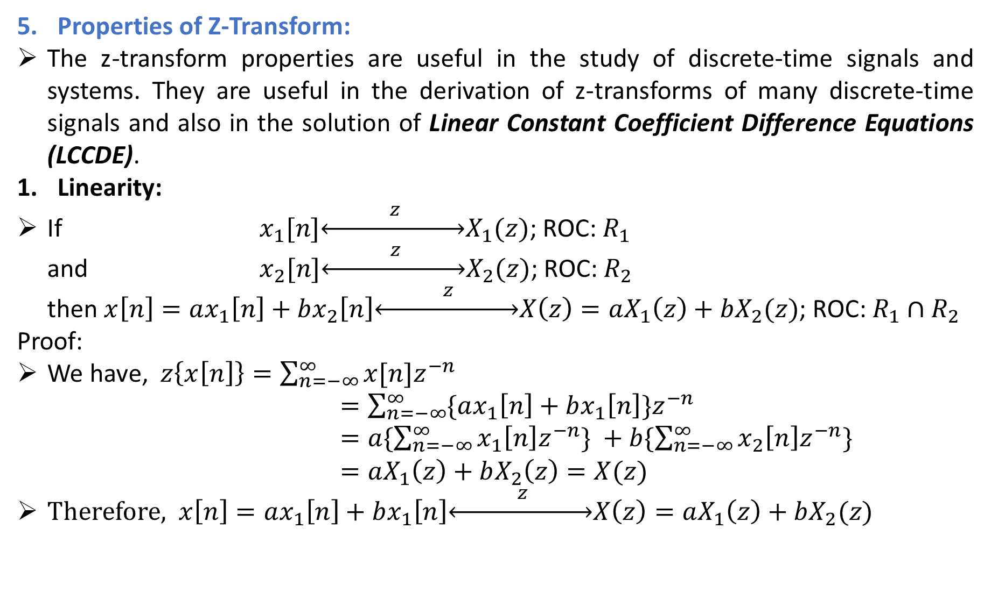
Properties of Z-Transform:
The z-transform properties are useful in the study of discrete-time signals and systems. They are useful in the derivation of z-transforms of many discrete-time signals and also in the solution of Linear Constant Coefficient Difference Equations (LCCDE).
Linearity:
If $x_{1}[n]\underset{↔}{ z }X_{1}(z)$; ROC: $R_{1}$
and $x_{2}[n]\underset{↔}{ z }X_{2}(z)$; ROC: $R_{2}$
then $x\left[n\right]=ax_{1}\left[n\right]+bx_{2}\left[n\right]\underset{↔}{ z }X\left(z\right)=aX_{1}\left(z\right)+bX_{2}(z)$; ROC: $R_{1}∩R_{2}$
Proof:
We have, $z\left\{x\left[n\right]\right\}=\sum_{n=−∞}^{∞}{x[n]z^{−n}}$
$=\sum_{n=−∞}^{∞}{\{ax_{1}\left[n\right]+bx_{1}\left[n\right]\}z^{−n}}$
$=a\{\sum_{n=−∞}^{∞}{x_{1}\left[n\right]z^{−n}\} +b\{\sum_{n=−∞}^{∞}{x_{2}\left[n\right]z^{−n}\} }}$
$=aX_{1}\left(z\right)+bX_{2}\left(z\right)=X(z)$
Therefore, $x\left[n\right]=ax_{1}\left[n\right]+bx_{1}\left[n\right]\underset{↔}{ z }X\left(z\right)=aX_{1}\left(z\right)+bX_{2}(z)$

Slide 10
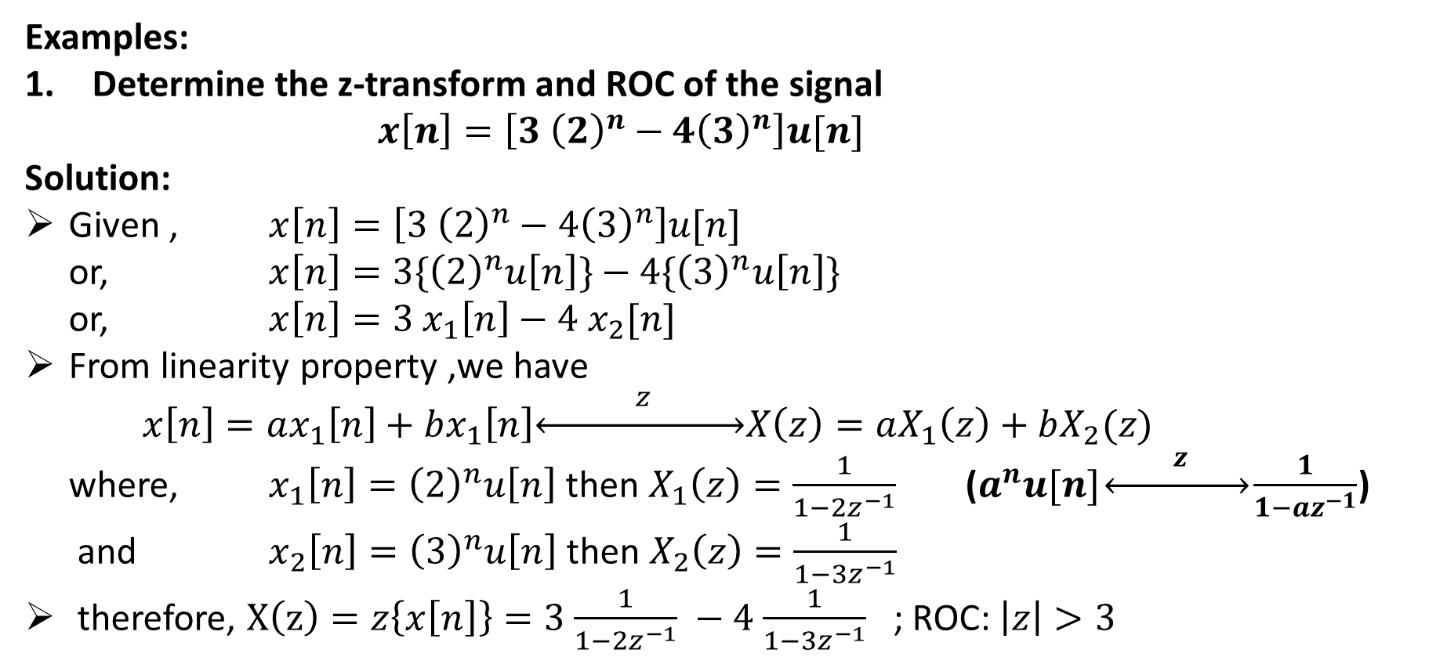
Examples:
Determine the z-transform and ROC of the signal
$x\left[n\right]=\left[3 {\left(2\right)}^{n}−4{\left(3\right)}^{n}\right]u[n]$
Solution:
Given , $x\left[n\right]=\left[3 {\left(2\right)}^{n}−4{\left(3\right)}^{n}\right]u[n]$
or, $x\left[n\right]=3\{{\left(2\right)}^{n}u\left[n\right]\}−4\{{\left(3\right)}^{n}u\left[n\right]\}$
or, $x\left[n\right]=3$ $x_{1}\left[n\right]−4{ x}_{2}[n]$
From linearity property ,we have
$x\left[n\right]=ax_{1}\left[n\right]+bx_{1}\left[n\right]\underset{↔}{ z }X\left(z\right)=aX_{1}\left(z\right)+bX_{2}(z)$
where, $x_{1}\left[n\right]={\left(2\right)}^{n}u\left[n\right]$ then $X_{1}\left(z\right)=\frac{1}{1−{2z}^{−1}}$ ($a^{n}u[n]\underset{↔}{ z }\frac{1}{1−{az}^{−1}}$)
and $x_{2}\left[n\right]={\left(3\right)}^{n}u\left[n\right]$ then $X_{2}\left(z\right)=\frac{1}{1−{3z}^{−1}}$
therefore, $X\left(z\right)=z\left\{x\left[n\right]\right\}=3$ $\frac{1}{1−{2z}^{−1}} −4$ $\frac{1}{1−{3z}^{−1}}$ ; ROC: $\left|z\right|>3$

Slide 11
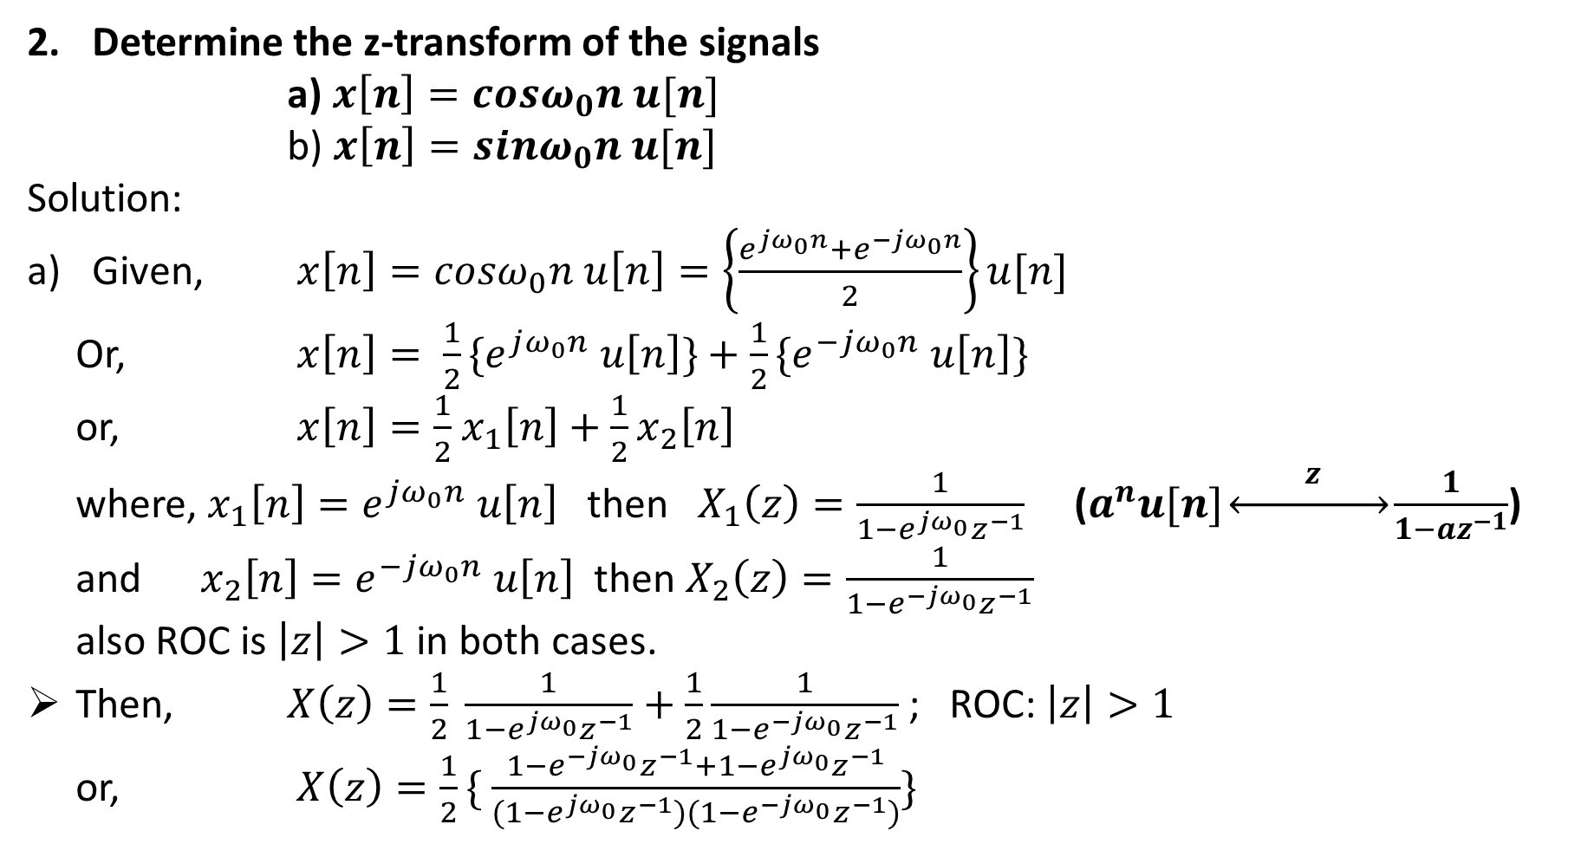
Determine the z-transform of the signals
a) $x\left[n\right]=cosω_{0}n u[n]$
b) $x\left[n\right]=sinω_{0}n u[n]$
Solution:
Given, $x\left[n\right]=cosω_{0}n u\left[n\right]=\left\{\frac{e^{jω_{0}n}+e^{−jω_{0}n}}{2}\right\}u[n]$
Or, $x\left[n\right]= \frac{1}{2}{\{e}^{jω_{0}n} u\left[n\right]\}+\frac{1}{2}\{e^{−jω_{0}n} u\left[n\right]\}$
or, $x\left[n\right]=\frac{1}{2}$ $x_{1}\left[n\right]+\frac{1}{2}x_{2}\left[n\right]$
where, $x_{1}\left[n\right]=e^{jω_{0}n} u\left[n\right]$ then $X_{1}\left(z\right)=\frac{1}{1−e^{jω_{0}}z^{−1}}$ ($a^{n}u[n]\underset{↔}{ z }\frac{1}{1−{az}^{−1}}$)
and $x_{2}\left[n\right]=e^{−jω_{0}n} u\left[n\right]$ then $X_{2}\left(z\right)=\frac{1}{1−e^{−jω_{0}}z^{−1}}$
also ROC is $\left|z\right|>1$ in both cases.
Then, $X\left(z\right)=\frac{1}{2} \frac{1}{1−e^{jω_{0}}z^{−1}}+\frac{1}{2}\frac{1}{1−e^{−jω_{0}}z^{−1}}$ ; ROC: $\left|z\right|>1$
or, $X\left(z\right)=\frac{1}{2}\{$ $\frac{1−e^{−jω_{0}}z^{−1}+1−e^{jω_{0}}z^{−1}}{(1−e^{jω_{0}}z^{−1})(1−e^{−jω_{0}}z^{−1})}\}$

Slide 12
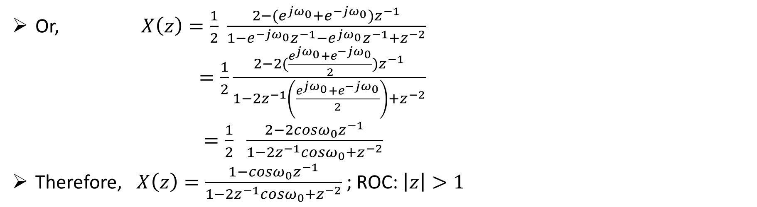
Or, $X\left(z\right)=\frac{1}{2} \frac{2−(e^{jω_{0}}+e^{−jω_{0}})z^{−1}}{1−e^{−jω_{0}}z^{−1}−e^{jω_{0}}z^{−1}+z^{−2}}$
$=\frac{1}{2}\frac{2−2(\frac{e^{jω_{0}}+e^{−jω_{0}}}{2})z^{−1}}{1−2z^{−1}\left(\frac{e^{jω_{0}}+e^{−jω_{0}}}{2}\right)+z^{−2}}$
$=\frac{1}{2} \frac{2−2cosω_{0}z^{−1}}{1−2z^{−1}cosω_{0}+z^{−2}}$
Therefore, $X\left(z\right)=\frac{1−cosω_{0}z^{−1}}{1−2z^{−1}cosω_{0}+z^{−2}}$; ROC: $\left|z\right|>1$

Slide 13
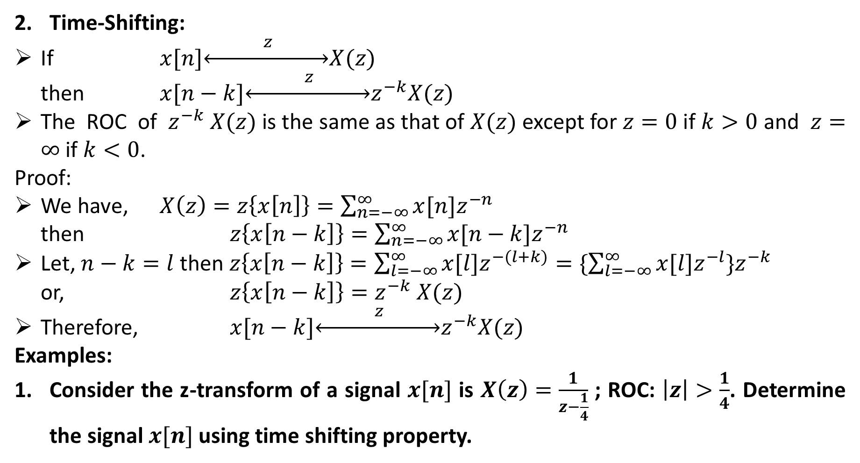
Time-Shifting:
If $x[n]\underset{↔}{ z }X(z)$
then $x[n−k]\underset{↔}{ z }z^{−k}X(z)$
The ROC of ${ z}^{−k} X(z)$ is the same as that of $X(z)$ except for $z=0$ if $k>0$ and $z=∞$ if $k<0$.
Proof:
We have, $X\left(z\right)=z\left\{x\left[n\right]\right\}=\sum_{n=−∞}^{∞}{x[n]z^{−n}}$
then $z\left\{x\left[n−k\right]\right\}=\sum_{n=−∞}^{∞}{x[n−k]z^{−n}}$
Let, $n−k=l$ then $z\left\{x\left[n−k\right]\right\}=\sum_{l=−∞}^{∞}{x[l]z^{−(l+k)}}=\{\sum_{l=−∞}^{∞}{x[l]z^{−l}\}z^{−k}}$
or, $z\left\{x\left[n−k\right]\right\}=z^{−k} X(z)$
Therefore, $x[n−k]\underset{↔}{ z }z^{−k}X(z)$
Examples:
Consider the z-transform of a signal $x[n]$ is $X\left(z\right)=\frac{1}{z−\frac{1}{4}}$ ; ROC: $\left|z\right|>\frac{1}{4}$. Determine the signal $x[n]$ using time shifting property.

Slide 14
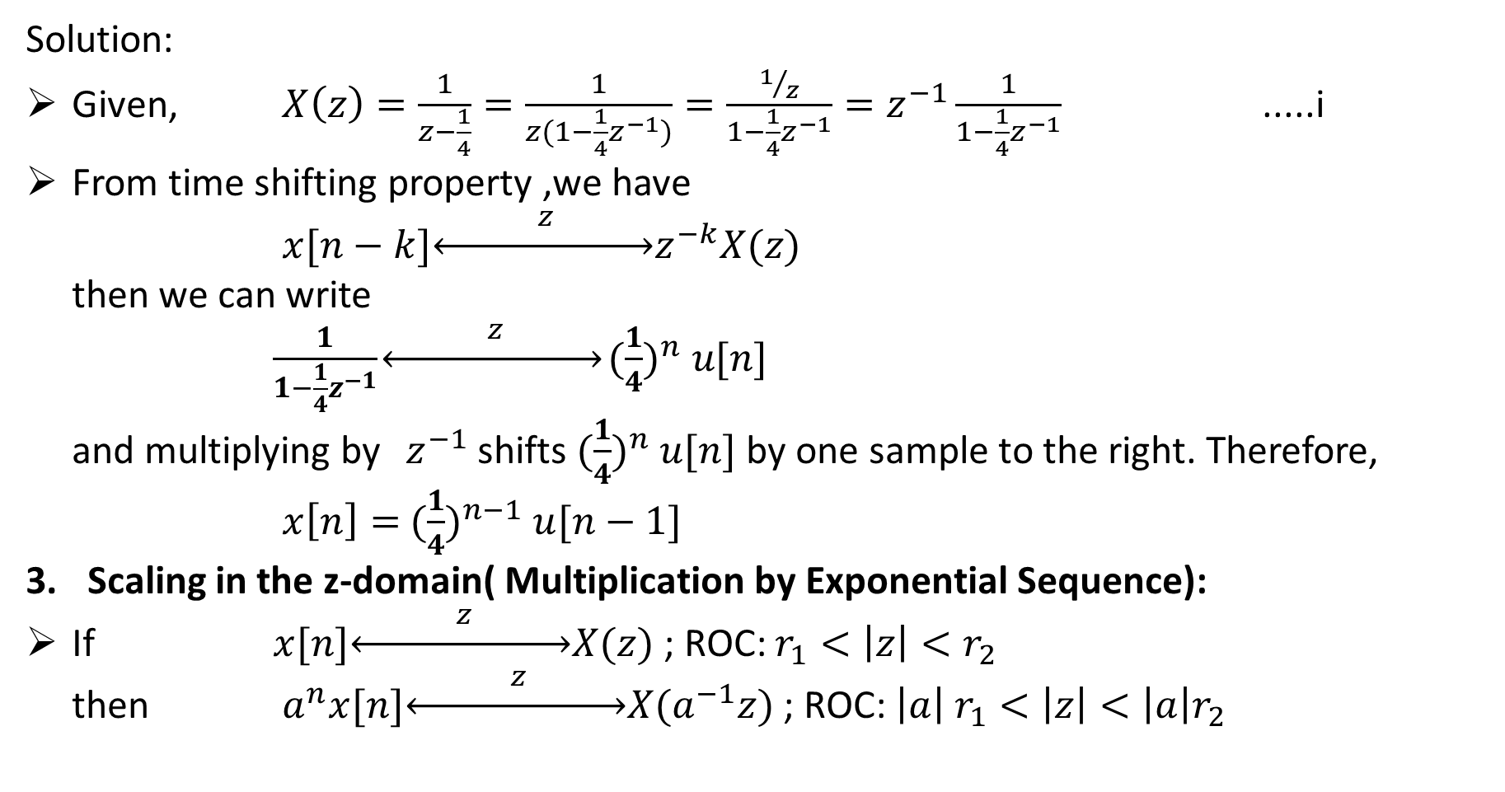
Solution:
Given, $X\left(z\right)=\frac{1}{z−\frac{1}{4}}=\frac{1}{z(1−\frac{1}{4}z^{−1})}=\frac{1/z}{1−\frac{1}{4}z^{−1}}=z^{−1}\frac{1}{1−\frac{1}{4}z^{−1}}$ .....i
From time shifting property ,we have
$x[n−k]\underset{↔}{ z }z^{−k}X(z)$
then we can write
$\frac{1}{1−\frac{1}{4}z^{−1}}\underset{↔}{ z }{(\frac{1}{4})}^{n} u[n]$
and multiplying by $z^{−1}$shifts ${(\frac{1}{4})}^{n} u[n]$by one sample to the right. Therefore,
$x\left[n\right]=$ ${(\frac{1}{4})}^{n−1} u[n−1]$
Scaling in the z-domain( Multiplication by Exponential Sequence):
If $x[n]\underset{↔}{ z }X(z)$ ; ROC: $r_{1}<\left|z\right|<r_{2}$
then $a^{n}x[n]\underset{↔}{ z }X(a^{−1}z)$ ; ROC: $\left|a\right|$ $r_{1}<\left|z\right|<\left|a\right|r_{2}$

Slide 15
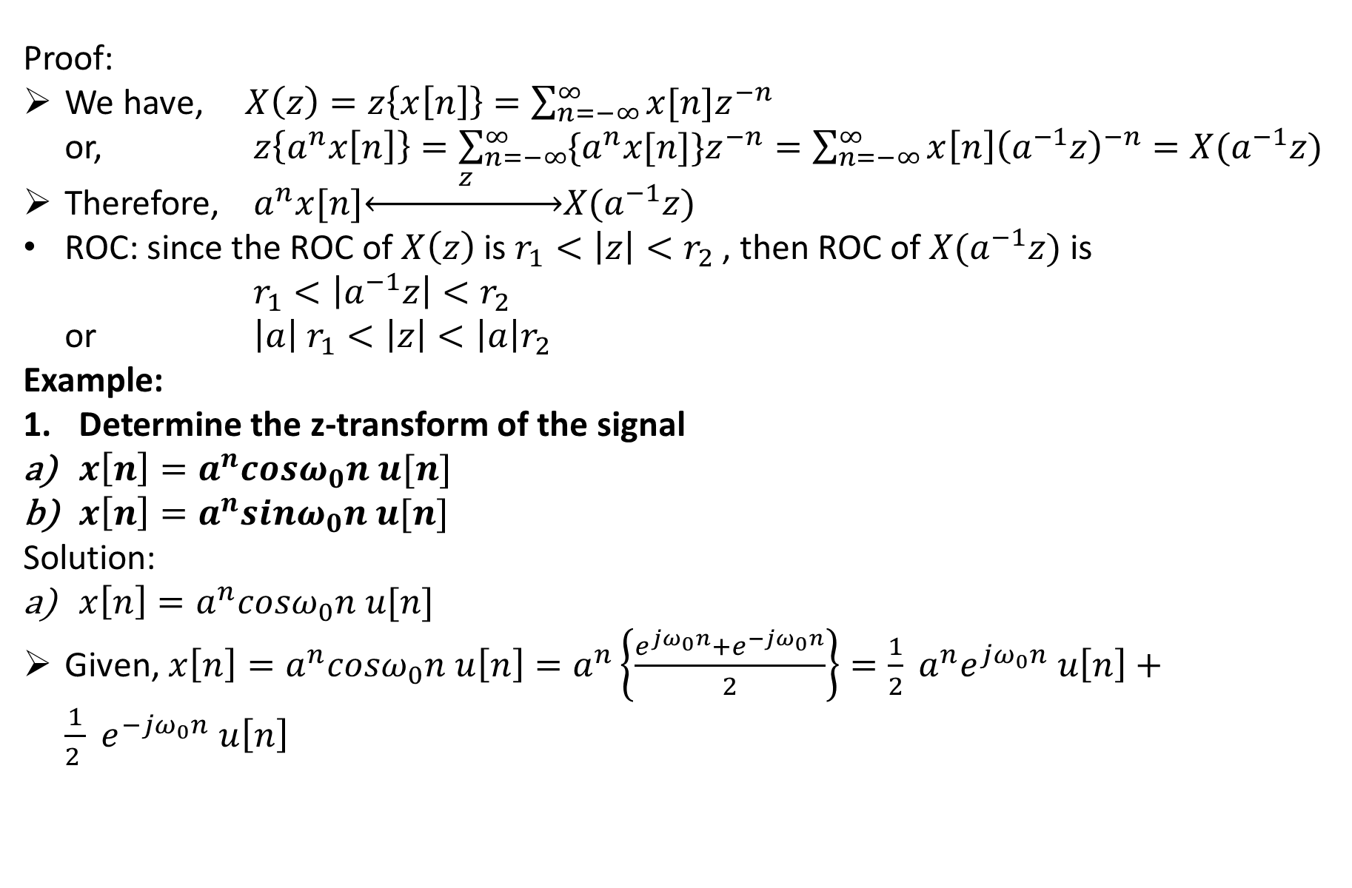
Proof:
We have, $X\left(z\right)=z\left\{x\left[n\right]\right\}=\sum_{n=−∞}^{∞}{x[n]z^{−n}}$
or, $z\left\{a^{n}x\left[n\right]\right\}=\sum_{n=−∞}^{∞}{{\{a}^{n}x[n]\}z^{−n}=\sum_{n=−∞}^{∞}{x\left[n\right]{\left(a^{−1}z\right)}^{−n}=X(a^{−1}z)}}$
Therefore, $a^{n}x[n]\underset{↔}{ z }X(a^{−1}z)$
ROC: since the ROC of $X\left(z\right)$ is $r_{1}<\left|z\right|<r_{2}$ , then ROC of $X(a^{−1}z)$ is
$r_{1}<\left|a^{−1}z\right|<r_{2}$
or $\left|a\right|$ $r_{1}<\left|z\right|<\left|a\right|r_{2}$
Example:
Determine the z-transform of the signal
$x\left[n\right]=a^{n}cosω_{0}n u[n]$
$x\left[n\right]=a^{n}sinω_{0}n u[n]$
Solution:
$x\left[n\right]=a^{n}cosω_{0}n u[n]$
Given, $x\left[n\right]=a^{n}cosω_{0}n u\left[n\right]=a^{n}\left\{\frac{e^{jω_{0}n}+e^{−jω_{0}n}}{2}\right\}=\frac{1}{2}{ a^{n}e}^{jω_{0}n} u\left[n\right]+\frac{1}{2 } e^{−jω_{0}n} u\left[n\right]$

Slide 16
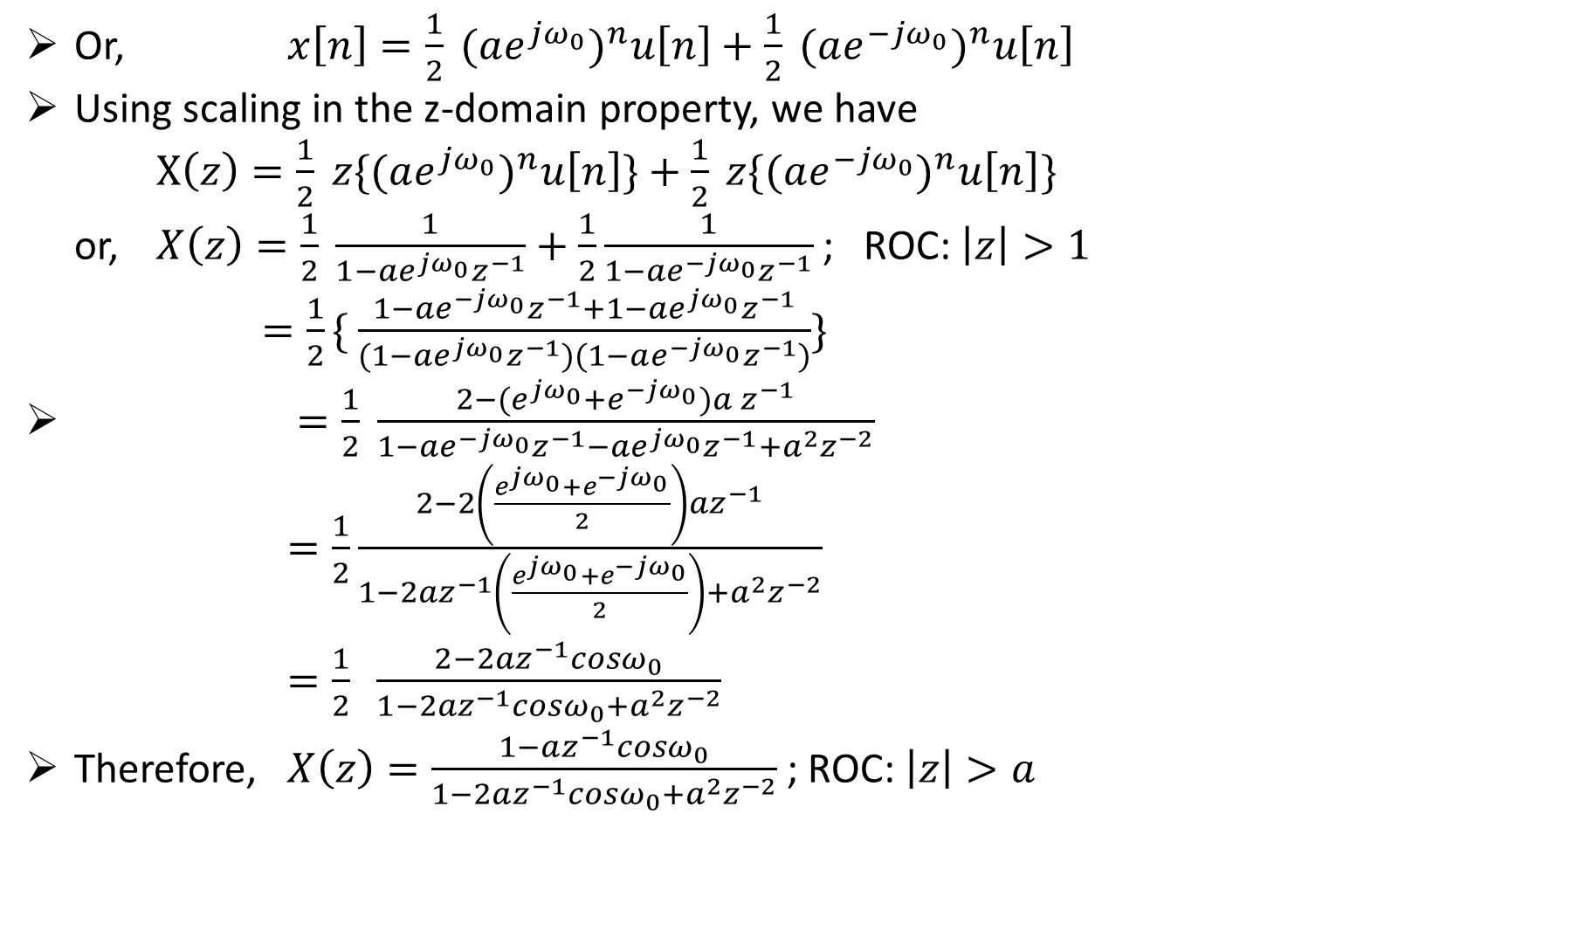
Or, $x\left[n\right]=\frac{1}{2}{ (ae^{jω_{0}})}^{n}u\left[n\right]+\frac{1}{2}{ (ae^{−jω_{0}})}^{n}u\left[n\right]$
Using scaling in the z-domain property, we have
$X\left(z\right)=\frac{1}{2}{ z\{(ae^{jω_{0}})}^{n}u\left[n\right]\}+\frac{1}{2}{ z\{(ae^{−jω_{0}})}^{n}u\left[n\right]\}$
or, $X\left(z\right)=\frac{1}{2} \frac{1}{1−ae^{jω_{0}}z^{−1}}+\frac{1}{2}\frac{1}{1−{ae}^{−jω_{0}}z^{−1}}$ ; ROC: $\left|z\right|>1$
$=\frac{1}{2}\{$ $\frac{1−ae^{−jω_{0}}z^{−1}+1−ae^{jω_{0}}z^{−1}}{(1−ae^{jω_{0}}z^{−1})(1−ae^{−jω_{0}}z^{−1})}\}$
$=\frac{1}{2} \frac{2−(e^{jω_{0}}+e^{−jω_{0}}){a z}^{−1}}{1−ae^{−jω_{0}}z^{−1}−{ae}^{jω_{0}}z^{−1}+a^{2}z^{−2}}$
$=\frac{1}{2}\frac{2−2\left(\frac{e^{jω_{0}}+e^{−jω_{0}}}{2}\right)az^{−1}}{1−2az^{−1}\left(\frac{e^{jω_{0}}+e^{−jω_{0}}}{2}\right)+a^{2}z^{−2}}$
$=\frac{1}{2} \frac{2−2{az}^{−1}cosω_{0}}{1−2{az}^{−1}cosω_{0}+a^{2}z^{−2}}$
Therefore, $X\left(z\right)=\frac{1−az^{−1}cosω_{0}}{1−2az^{−1}cosω_{0}+a^{2}z^{−2}}$; ROC: $\left|z\right|>a$

Slide 17
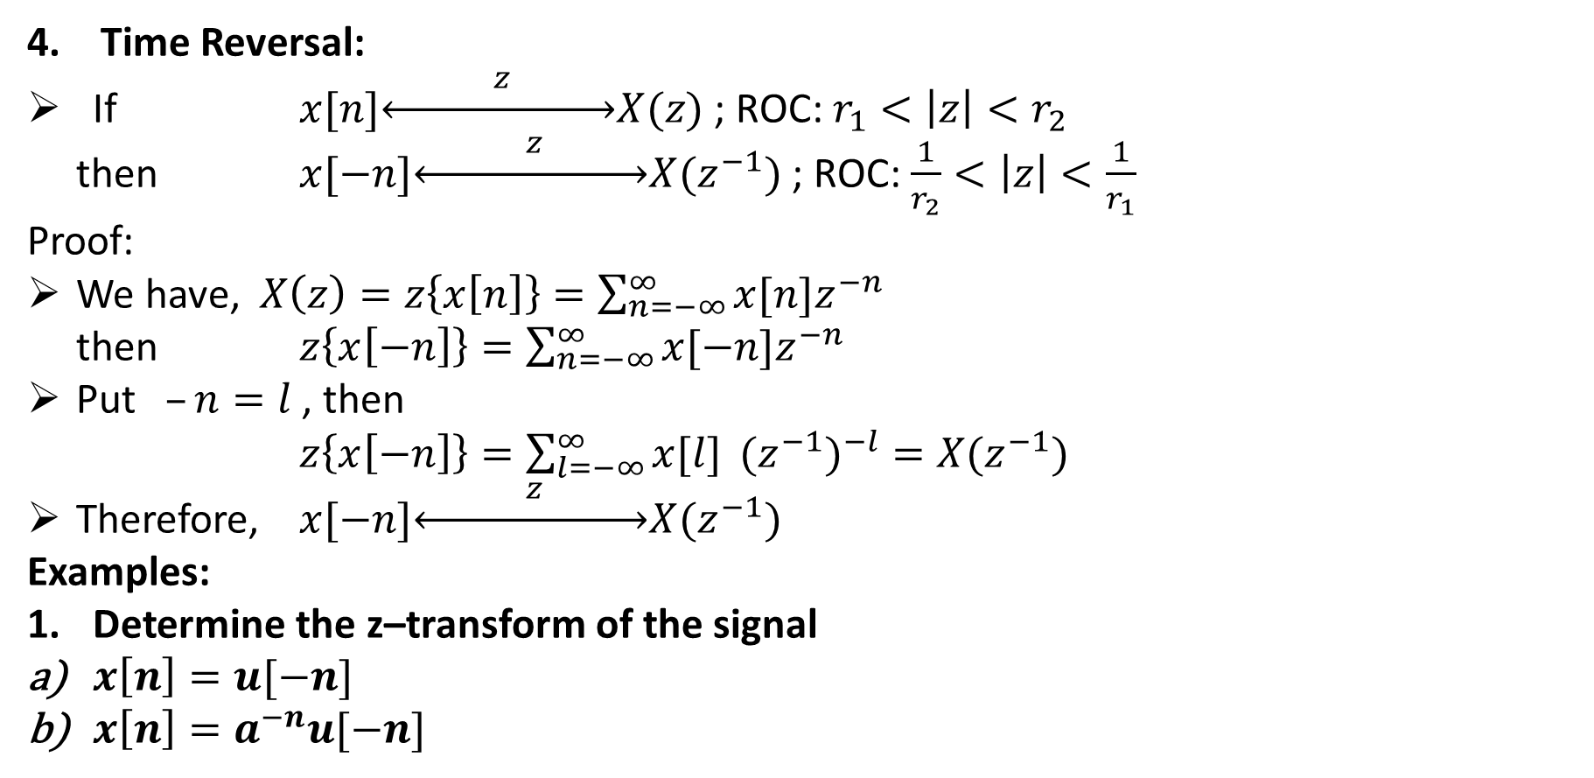
Time Reversal:
If $x[n]\underset{↔}{ z }X(z)$ ; ROC: $r_{1}<\left|z\right|<r_{2}$
then $x[−n]\underset{↔}{ z }X(z^{−1})$ ; ROC: $\frac{1}{r_{2}}<\left|z\right|<\frac{1}{r_{1}}$
Proof:
We have, $X\left(z\right)=z\left\{x\left[n\right]\right\}=\sum_{n=−∞}^{∞}{x[n]z^{−n}}$
then $z\left\{x\left[−n\right]\right\}=\sum_{n=−∞}^{∞}{x[−n]z^{−n}}$
Put $–n=l$ , then
$z\left\{x\left[−n\right]\right\}=\sum_{l=−∞}^{∞}{x[l] }{{(z}^{−1})}^{−l}=X(z^{−1})$
Therefore, $x[−n]\underset{↔}{ z }X(z^{−1})$
Examples:
Determine the z–transform of the signal
$x\left[n\right]=u[−n]$
$x\left[n\right]=a^{−n}u[−n]$

Slide 18
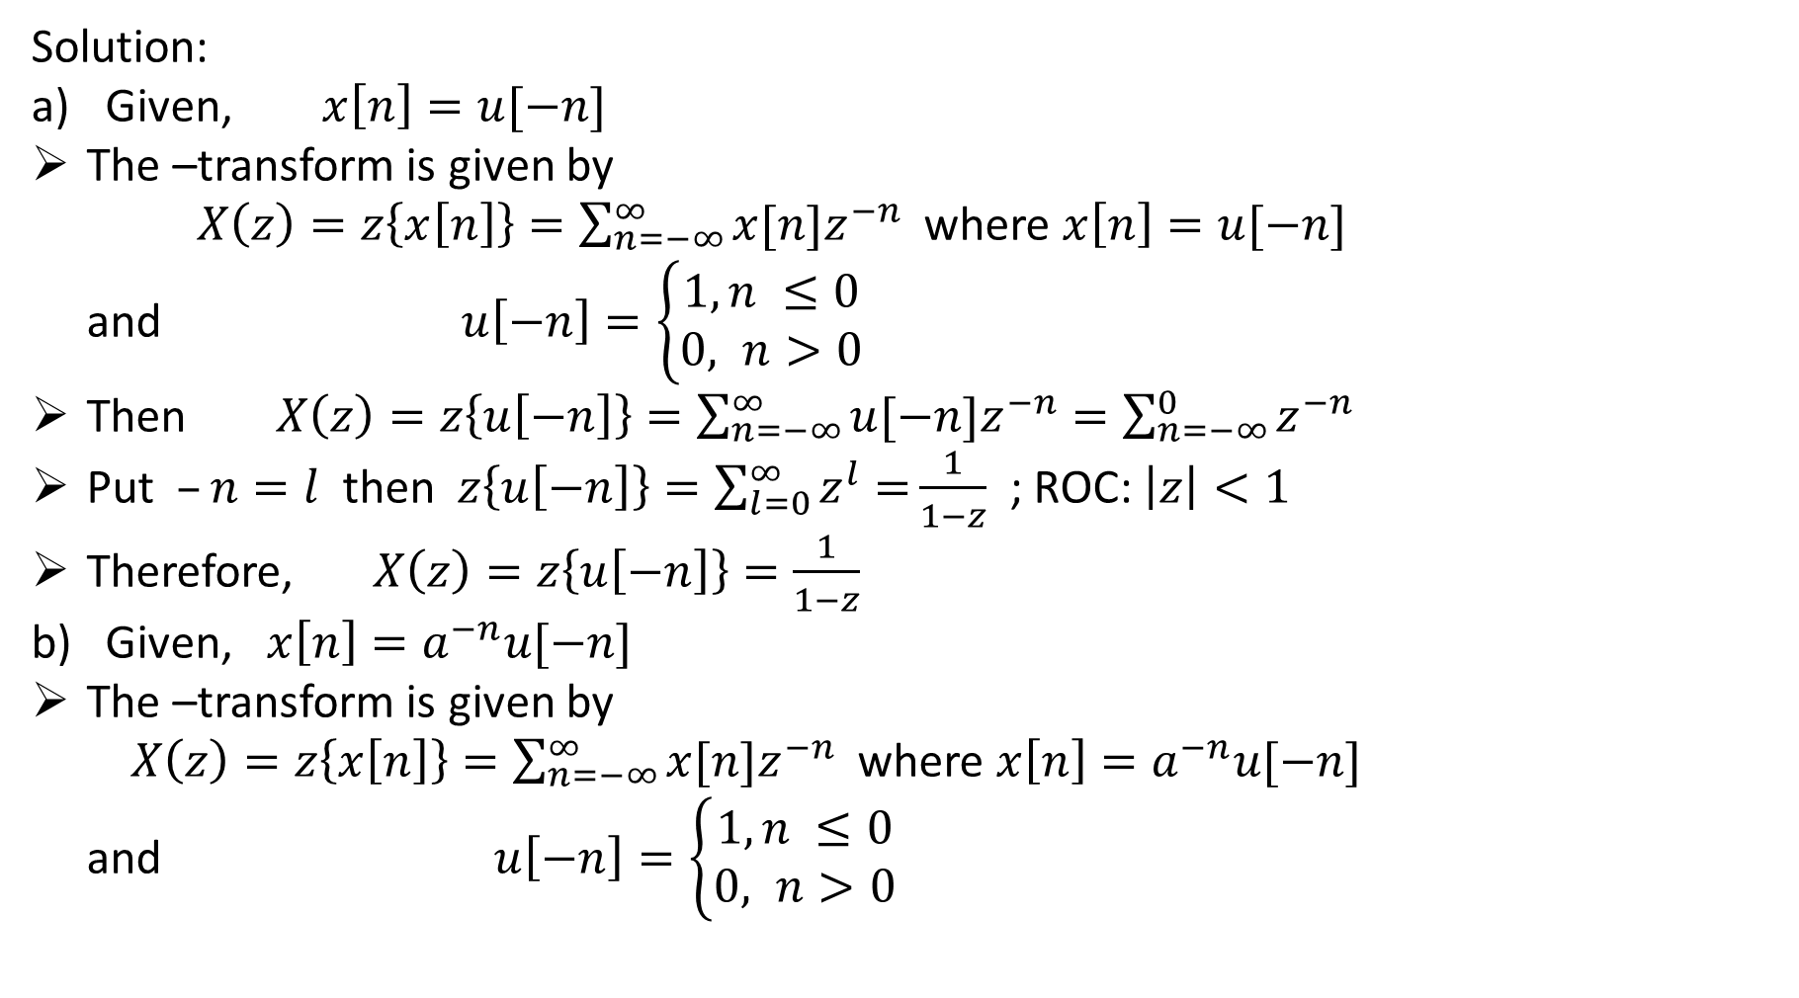
Solution:
Given, $x\left[n\right]=u[−n]$
The –transform is given by
$X\left(z\right)=z\left\{x\left[n\right]\right\}=\sum_{n=−∞}^{∞}{x[n]z^{−n}}$ where $x\left[n\right]=u[−n]$
and $u\left[−n\right]=\left\{\begin{aligned}1, n ≤0 \\ 0, n>0\end{aligned}\right.$
Then $X\left(z\right)=z\left\{u\left[−n\right]\right\}=\sum_{n=−∞}^{∞}{u[−n]z^{−n}}=\sum_{n=−∞}^{0}{z^{−n}}$
Put $–n=l$ then $z\left\{u\left[−n\right]\right\}=\sum_{l=0}^{∞}{z^{l}=}\frac{1}{1−z}$ ; ROC: $\left|z\right|<1$
Therefore, $X\left(z\right)=z\left\{u\left[−n\right]\right\}=\frac{1}{1−z}$
Given, $x\left[n\right]=a^{−n}u[−n]$
The –transform is given by
$X\left(z\right)=z\left\{x\left[n\right]\right\}=\sum_{n=−∞}^{∞}{x[n]z^{−n}}$ where $x\left[n\right]=a^{−n}u[−n]$
and $u\left[−n\right]=\left\{\begin{aligned}1, n ≤0 \\ 0, n>0\end{aligned}\right.$

Slide 19
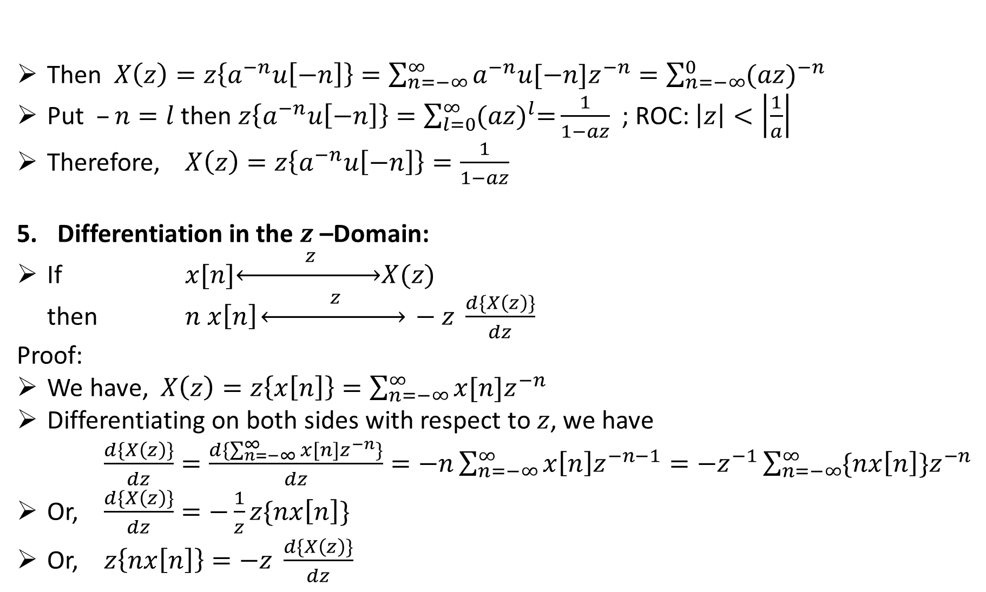
Then $X\left(z\right)=z\left\{a^{−n}u\left[−n\right]\right\}=\sum_{n=−∞}^{∞}{a^{−n}u[−n]z^{−n}}=\sum_{n=−∞}^{0}{{(az)}^{−n}}$
Put $–n=l$ then $z\left\{a^{−n}u\left[−n\right]\right\}=\sum_{l=0}^{∞}{{(az)}^{l}=}\frac{1}{1−az}$ ; ROC: $\left|z\right|<\left|\frac{1}{a}\right|$
Therefore, $X\left(z\right)=z\left\{a^{−n}u\left[−n\right]\right\}=\frac{1}{1−az}$
Differentiation in the $z$–Domain:
If $x[n]\underset{↔}{ z }X(z)$
then $n x\left[n\right]\underset{↔}{ z } −z \frac{d\{X\left(z\right)\}}{dz}$
Proof:
We have, $X\left(z\right)=z\left\{x\left[n\right]\right\}=\sum_{n=−∞}^{∞}{x[n]z^{−n}}$
Differentiating on both sides with respect to $z$, we have
$\frac{d\{X\left(z\right)\}}{dz}=\frac{d\{\sum_{n=−∞}^{∞}{x[n]z^{−n}}\}}{dz}=−n\sum_{n=−∞}^{∞}{x\left[n\right]z^{−n−1}=−z^{−1}}\sum_{n=−∞}^{∞}{\{nx\left[n\right]\}z^{−n}}$
Or, $\frac{d\{X\left(z\right)\}}{dz}=−\frac{1}{z}z\{nx\left[n\right]\}$
Or, $z\left\{nx\left[n\right]\right\}=−z \frac{d\{X\left(z\right)\}}{dz}$

Slide 20
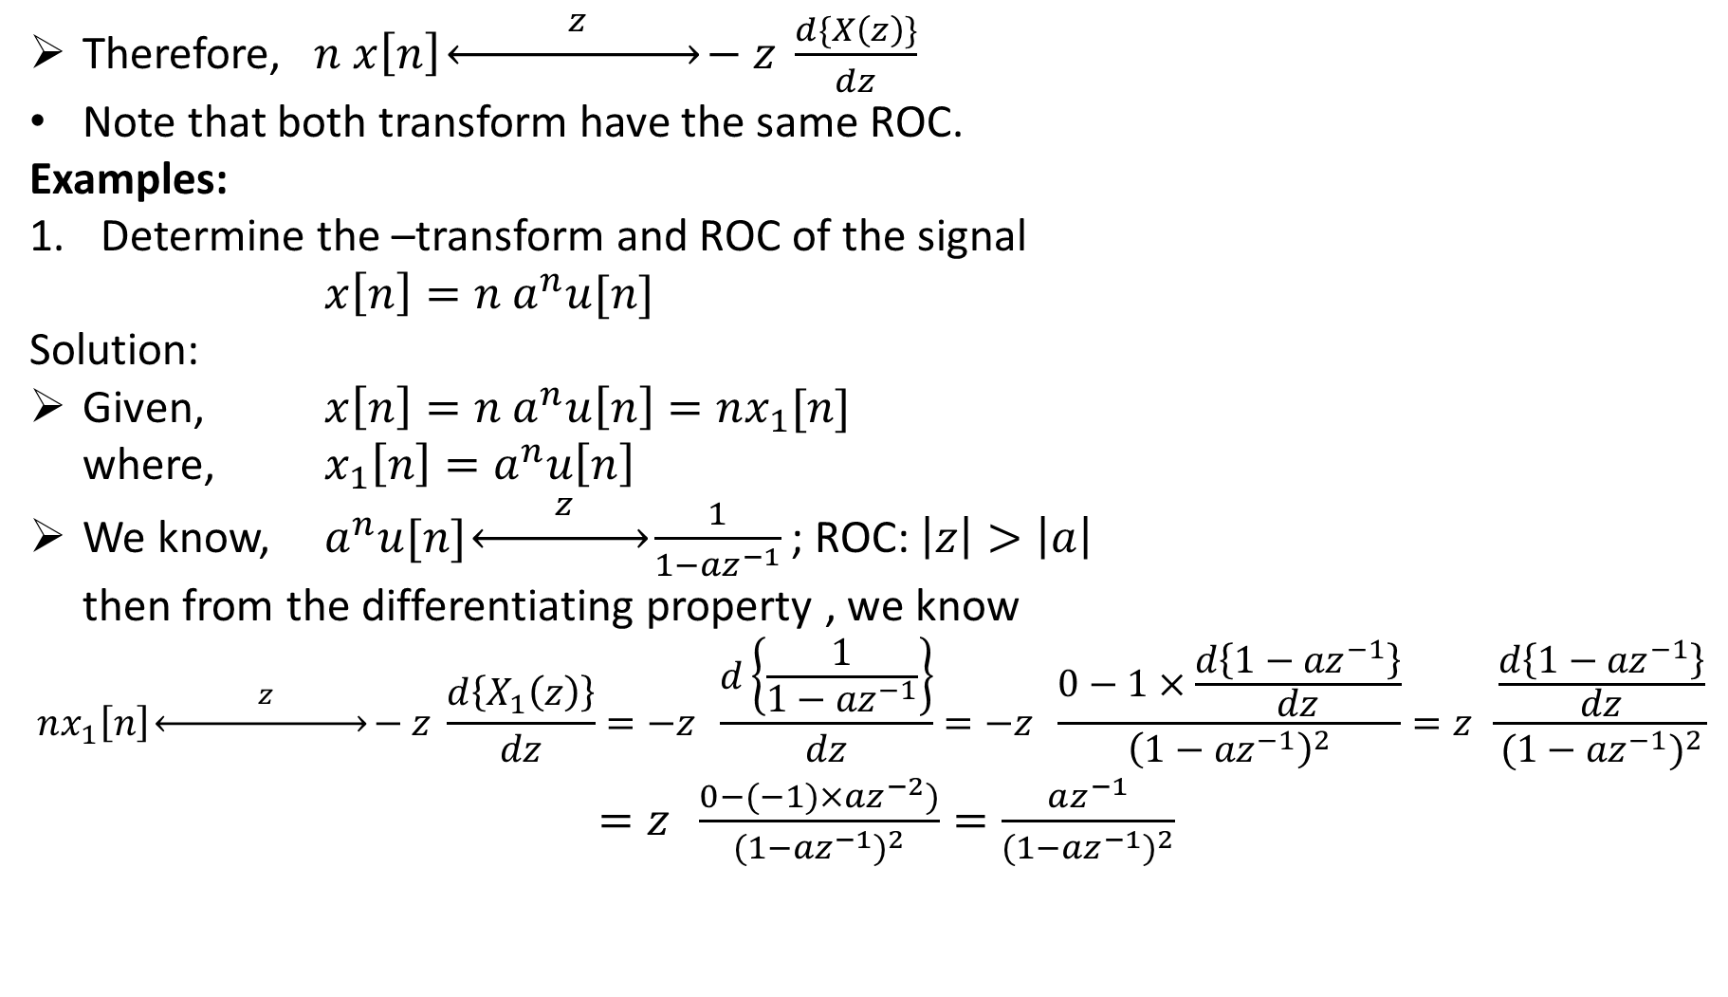
Therefore, $n x\left[n\right]\underset{↔}{ z }−z \frac{d\{X\left(z\right)\}}{dz}$
Note that both transform have the same ROC.
Examples:
Determine the –transform and ROC of the signal
$x\left[n\right]=n a^{n}u[n]$
Solution:
Given, $x\left[n\right]=n a^{n}u\left[n\right]=nx_{1}[n]$
where, $x_{1}\left[n\right]=a^{n}u\left[n\right]$
We know, $a^{n}u[n]\underset{↔}{ z }\frac{1}{1−{az}^{−1}}$ ; ROC: $\left|z\right|>\left|a\right|$
then from the differentiating property , we know
$$nx_{1}\left[n\right]\underset{↔}{ z }−z \frac{d\left\{X_{1}\left(z\right)\right\}}{dz}=−z \frac{d\left\{\frac{1}{1−{az}^{−1}}\right\}}{dz}=−z \frac{0−1×\frac{d\left\{1−{az}^{−1}\right\}}{dz}}{{\left(1−{az}^{−1}\right)}^{2}}=z \frac{\frac{d\left\{1−{az}^{−1}\right\}}{dz}}{{(1−{az}^{−1})}^{2}}$$
$=z \frac{0−(−1)×az^{−2})}{{(1−{az}^{−1})}^{2}}=\frac{az^{−1}}{{(1−{az}^{−1})}^{2}}$

Slide 21

Therefore, $x\left[n\right]=na^{n}u\left[n\right]\underset{↔}{ z }X\left(z\right)=\frac{az^{−1})}{{(1−{az}^{−1})}^{2}}$
Note that if $a=1$, then $x\left[n\right]=n u\left[n\right]$ then we can write
$x\left[n\right]=nu\left[n\right]\underset{↔}{ z }X\left(z\right)=\frac{z^{−1}}{{(1−z^{−1})}^{2}}$

Slide 22
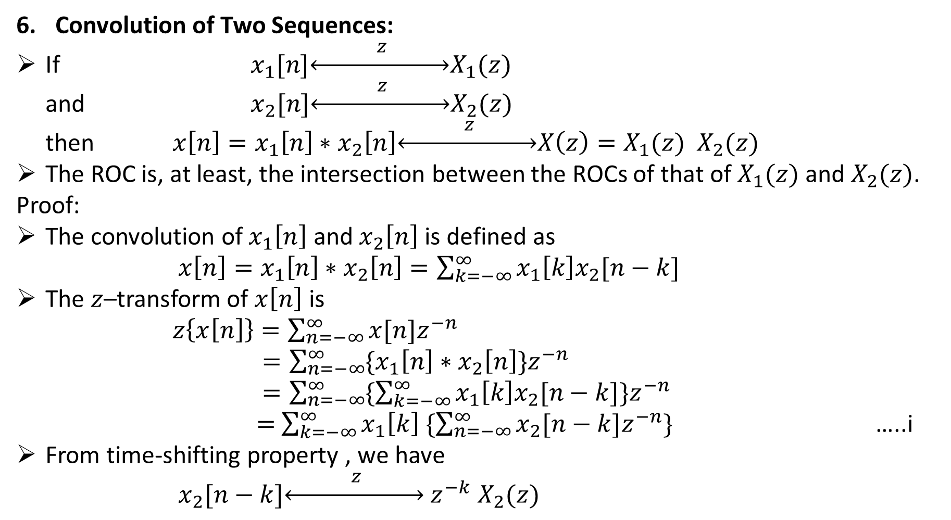
Convolution of Two Sequences:
If $x_{1}[n]\underset{↔}{ z }X_{1}(z)$
and $x_{2}[n]\underset{↔}{ z }X_{2}(z)$
then $x\left[n\right]=x_{1}\left[n\right]∗x_{2}\left[n\right]\underset{↔}{ z }X\left(z\right)=X_{1}(z){ X}_{2}(z)$
The ROC is, at least, the intersection between the ROCs of that of $X_{1}(z)$ and $X_{2}(z)$.
Proof:
The convolution of $x_{1}\left[n\right]$ and $x_{2}\left[n\right]$ is defined as
$x\left[n\right]=x_{1}\left[n\right]∗x_{2}\left[n\right]=\sum_{k=−∞}^{∞}{x_{1}\left[k\right]x_{2}[n−k]}$
The $z$–transform of $x\left[n\right]$ is
$z\left\{x\left[n\right]\right\}=\sum_{n=−∞}^{∞}{x[n]z^{−n}}$
$=\sum_{n=−∞}^{∞}{\{x_{1}\left[n\right]∗x_{2}\left[n\right]\}z^{−n}}$
$=\sum_{n=−∞}^{∞}{\{\sum_{k=−∞}^{∞}{x_{1}\left[k\right]x_{2}[n−k]}\}z^{−n}}$
$=$ $\sum_{k=−∞}^{∞}{x_{1}\left[k\right] \{\sum_{n=−∞}^{∞}{x_{2}[n−k]z^{−n}}\}}$ …..i
From time-shifting property , we have
$x_{2}[n−k]\underset{↔}{ z }$ $z^{−k}$ $X_{2}(z)$

Slide 23
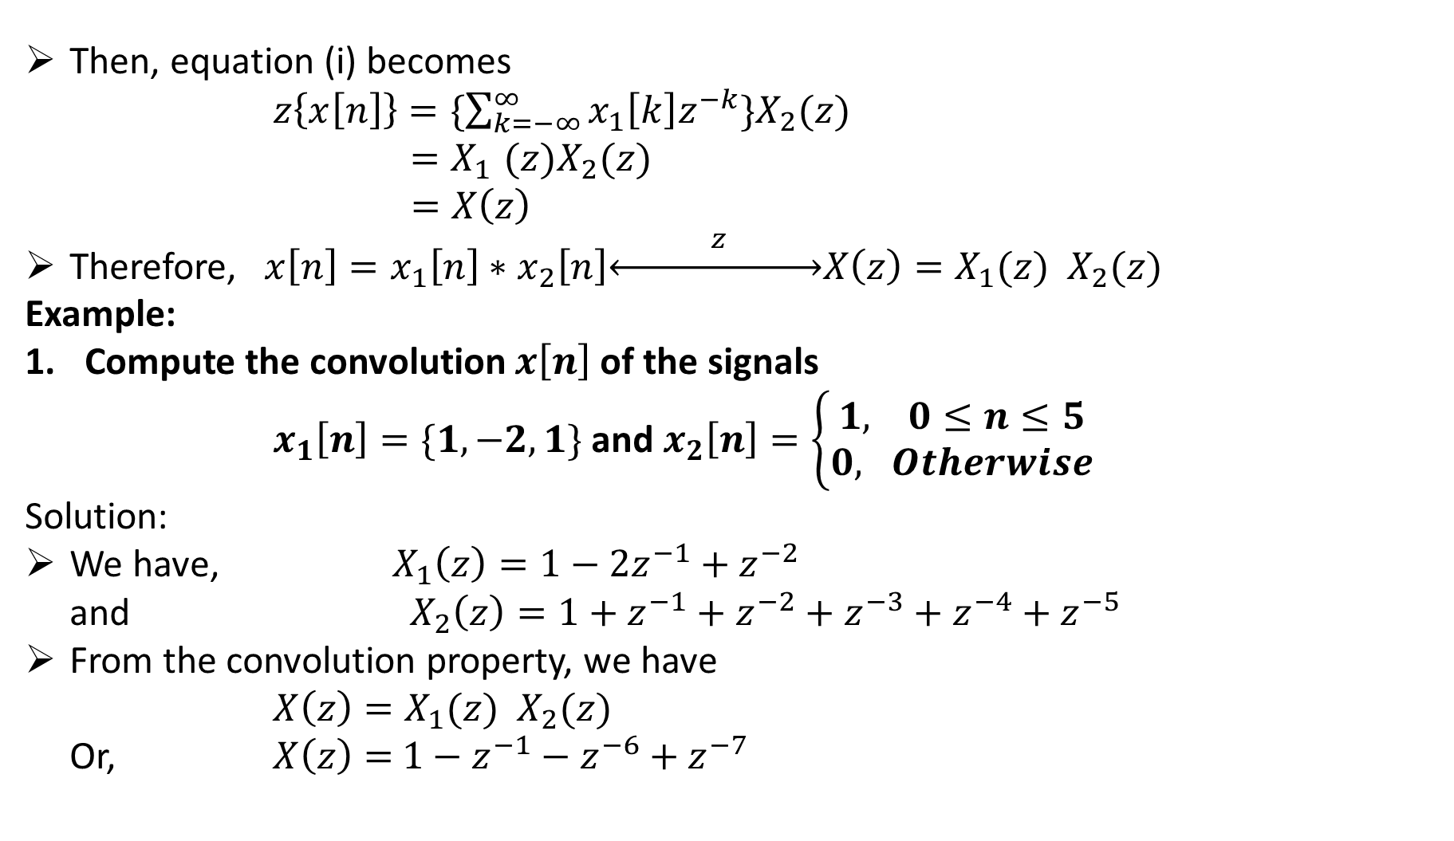
Then, equation (i) becomes
$z\left\{x\left[n\right]\right\}=\{\sum_{k=−∞}^{∞}{x_{1}\left[k\right]z^{−k}\}X_{2}(z)}$
${ {=X}_{1}(z)X}_{2}(z)$
$=X\left(z\right)$
Therefore, $x\left[n\right]=x_{1}\left[n\right]∗x_{2}\left[n\right]\underset{↔}{ z }X\left(z\right)=X_{1}(z){ X}_{2}(z)$
Example:
Compute the convolution $x\left[n\right]$ of the signals
$x_{1}\left[n\right]=\{1, −2, 1\}$ and $x_{2}\left[n\right]=\left\{\begin{aligned}1, 0≤n≤5 \\ 0, Otherwise\end{aligned}\right.$
Solution:
We have, $X_{1}\left(z\right)=1−2z^{−1}+z^{−2}$
and ${ X}_{2}\left(z\right)=1+z^{−1}+z^{−2}+z^{−3}+z^{−4}+z^{−5}$
From the convolution property, we have
$X\left(z\right)=X_{1}(z){ X}_{2}(z)$
Or, $X\left(z\right)=$ $1−z^{−1}−z^{−6}+z^{−7}$

Slide 24
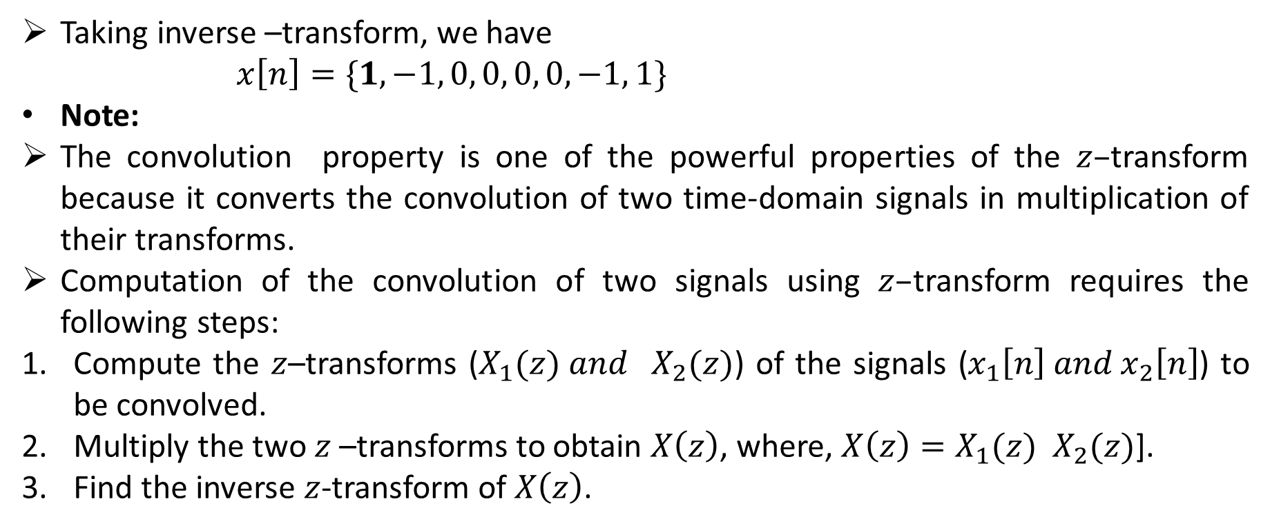
Taking inverse –transform, we have
$x\left[n\right]=\{1, −1, 0, 0, 0, 0, −1, 1\}$
Note:
The convolution property is one of the powerful properties of the $z–$transform because it converts the convolution of two time-domain signals in multiplication of their transforms.
Computation of the convolution of two signals using $z–$transform requires the following steps:
Compute the $z$–transforms ($X_{1}(z){ and X}_{2}(z)$) of the signals ($x_{1}\left[n\right] and x_{2}\left[n\right]$) to be convolved.
Multiply the two $z$–transforms to obtain $X\left(z\right)$, where, $X\left(z\right)=X_{1}(z){ X}_{2}(z)$].
Find the inverse $z$-transform of $X\left(z\right)$.

Slide 25
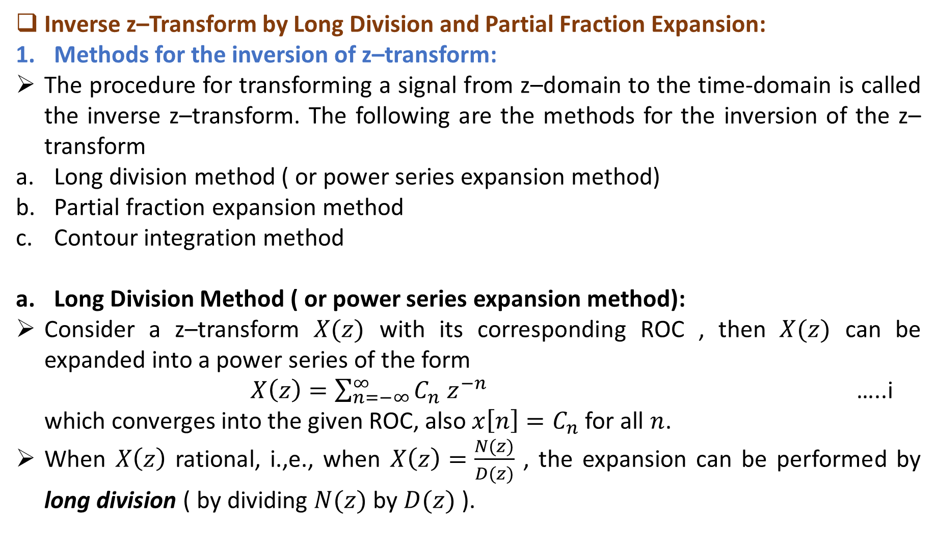
Inverse z–Transform by Long Division and Partial Fraction Expansion:
Methods for the inversion of z–transform:
The procedure for transforming a signal from z–domain to the time-domain is called the inverse z–transform. The following are the methods for the inversion of the z–transform
Long division method ( or power series expansion method)
Partial fraction expansion method
Contour integration method
Long Division Method ( or power series expansion method):
Consider a z–transform $X(z)$ with its corresponding ROC , then $X(z)$ can be expanded into a power series of the form
$X\left(z\right)=\sum_{n=−∞}^{∞}{C_{n}{ z}^{−n}}$ …..i
which converges into the given ROC, also $x\left[n\right]=C_{n}$ for all $n$.
When $X\left(z\right)$ rational, i.,e., when $X\left(z\right)=\frac{N(z)}{D(z)}$ , the expansion can be performed by long division ( by dividing $N(z)$ by $D(z)$ ).

Slide 26
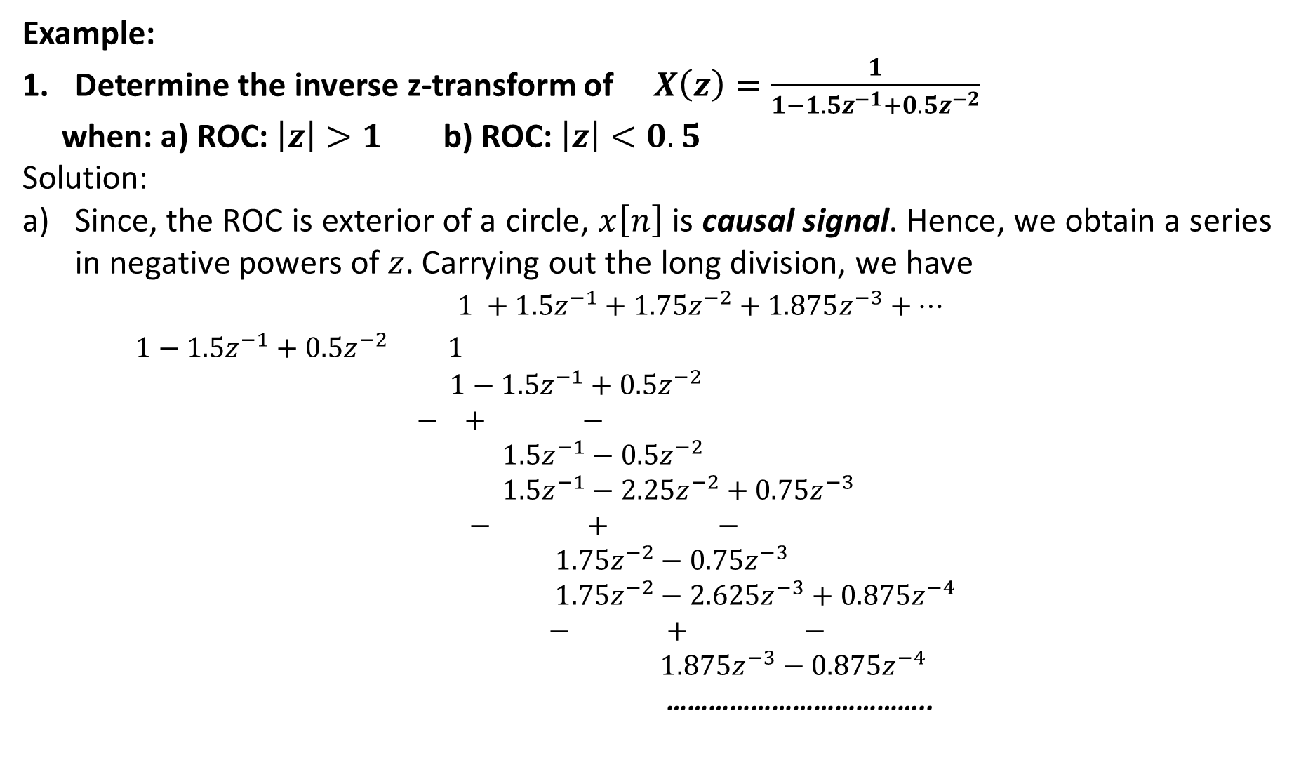
Example:
Determine the inverse z-transform of $X\left(z\right)=\frac{1}{1−1.5z^{−1}+0.5z^{−2}}$
when: a) ROC: $\left|z\right|>1$ b) ROC: $\left|z\right|<0.5$
Solution:
Since, the ROC is exterior of a circle, $x\left[n\right]$ is causal signal. Hence, we obtain a series in negative powers of $z$. Carrying out the long division, we have
$1 +1.5z^{−1}+1.75z^{−2}+1.875z^{−3}+…$
$1−1.5z^{−1}+0.5z^{−2}$ $1$
$1−1.5z^{−1}+0.5z^{−2}$
$− + −$
$1.5z^{−1}−0.5z^{−2}$
$1.5z^{−1}−2.25z^{−2}+0.75z^{−3}$
$− + −$
$1.75z^{−2}−0.75z^{−3}$
$1.75z^{−2}−2.625z^{−3}+0.875z^{−4}$
$− + −$
$1.875z^{−3}−0.875z^{−4}$
………………………………..

Slide 27
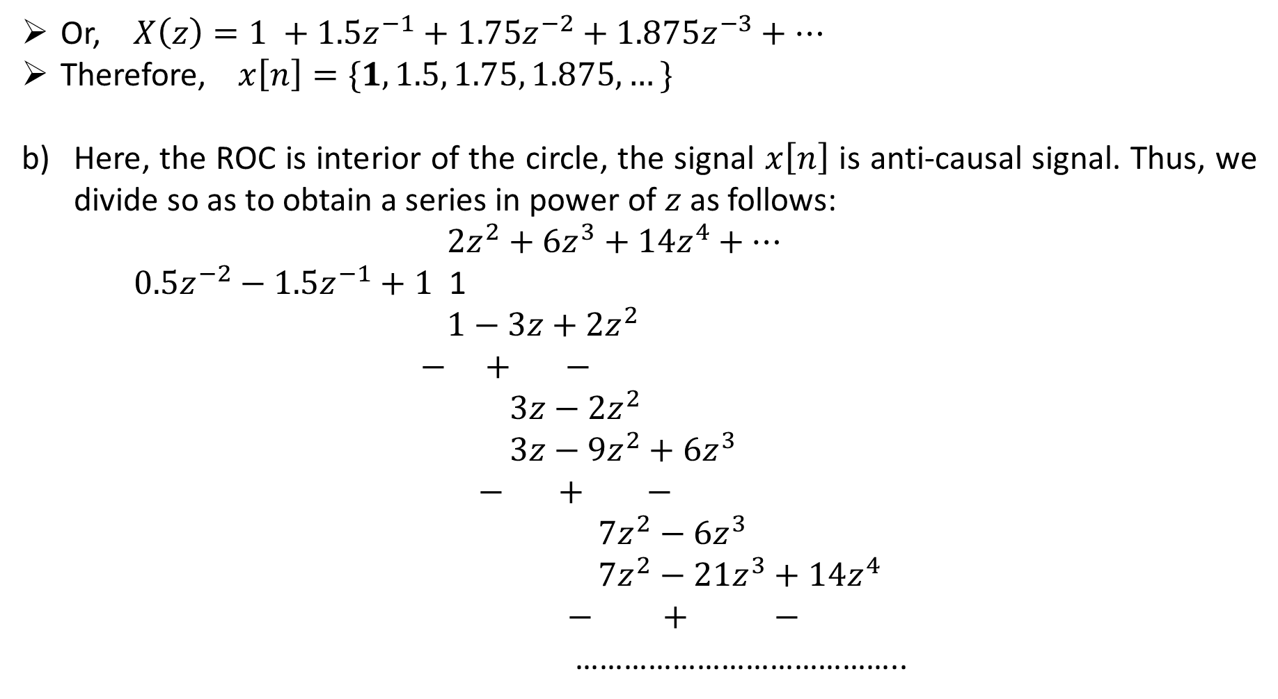
Or, $X\left(z\right)=1 +1.5z^{−1}+1.75z^{−2}+1.875z^{−3}+…$
Therefore, $x\left[n\right]=\{1, 1.5, 1.75, 1.875, …\}$
Here, the ROC is interior of the circle, the signal $x\left[n\right]$ is anti-causal signal. Thus, we divide so as to obtain a series in power of $z$ as follows:
$2z^{2}+6z^{3}+14z^{4}+…$
$0.5z^{−2}−1.5z^{−1}+1$ 1
$1−3z+2z^{2}$
$−$ $+$ $−$
$3z−2z^{2}$
$3z−9z^{2}+6z^{3}$
$−$ $+$ $−$
$7z^{2}−6z^{3}$
$7z^{2}−21z^{3}+14z^{4}$
$−$ $+$ $−$
…………………………………..

Slide 28
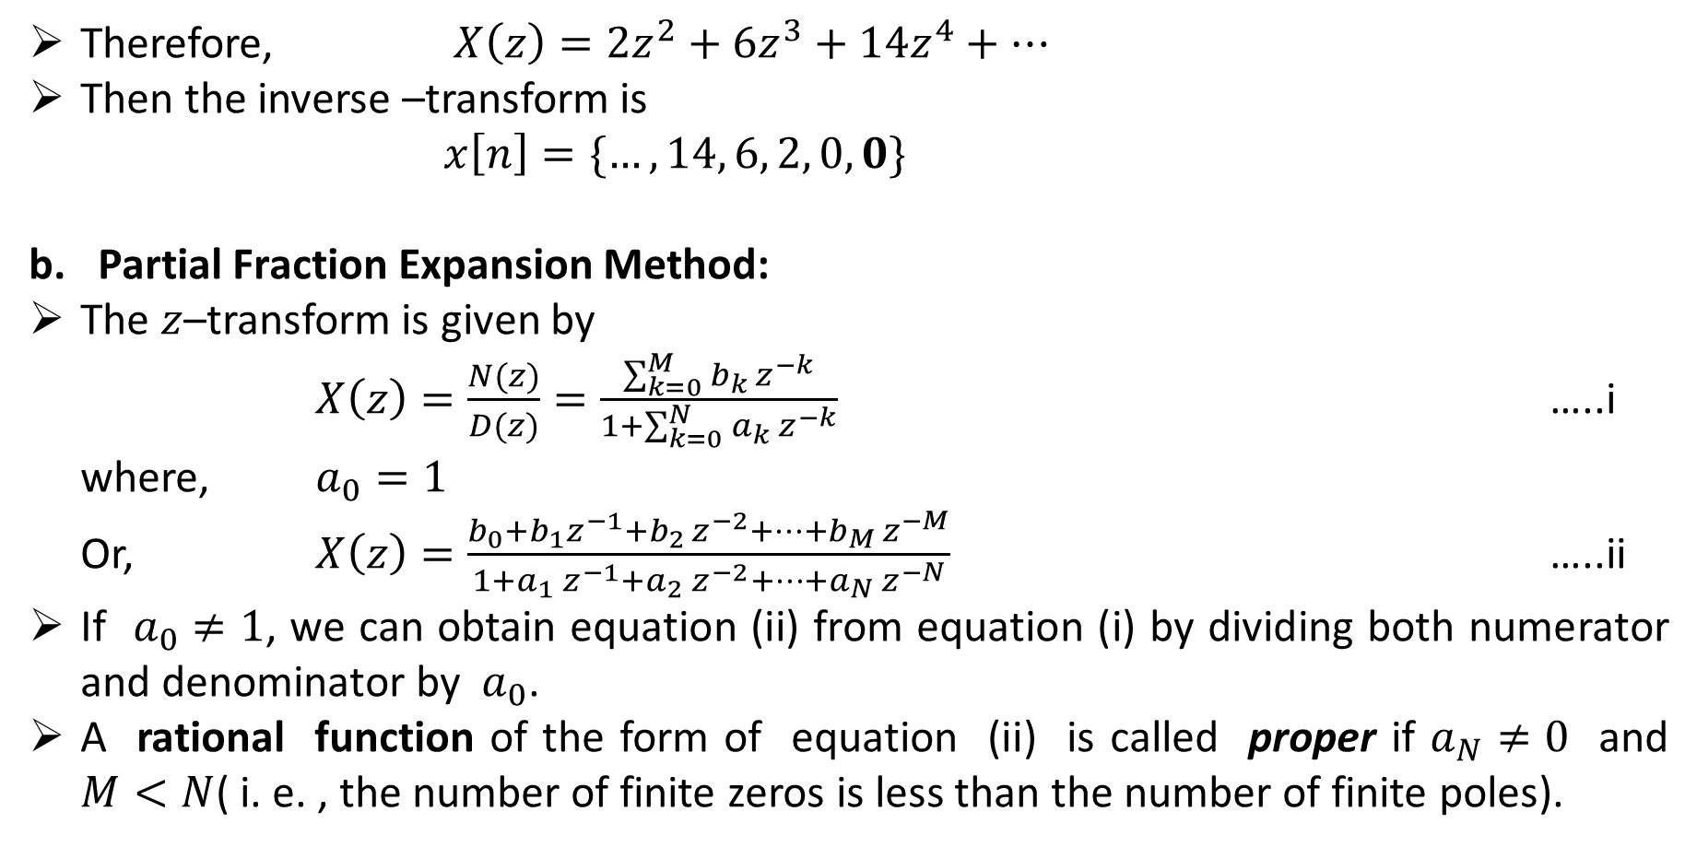
Therefore, $X\left(z\right)=2z^{2}+6z^{3}+14z^{4}+…$
Then the inverse –transform is
$x\left[n\right]=\{…,14, 6, 2, 0,0\}$
Partial Fraction Expansion Method:
The $z$–transform is given by
$X\left(z\right)=\frac{N(z)}{D(z)}=\frac{\sum_{k=0}^{M}{b_{k }z^{−k}}}{1+\sum_{k=0}^{N}{a_{k}{ z}^{−k}}}$ …..i
where, $a_{0}=1$
Or, $X\left(z\right)=\frac{b_{0}+b_{1}z^{−1}+b_{2 }z^{−2}+…+b_{M }z^{−M}}{1+a_{1}{ z}^{−1}+a_{2}{ z}^{−2}+…+a_{N}{ z}^{−N}}$ …..ii
If $a_{0}≠1$, we can obtain equation (ii) from equation (i) by dividing both numerator and denominator by $a_{0}$.
A rational function of the form of equation (ii) is called proper if $a_{N}≠0$ and $M<N$( i. e. , the number of finite zeros is less than the number of finite poles).

Slide 29
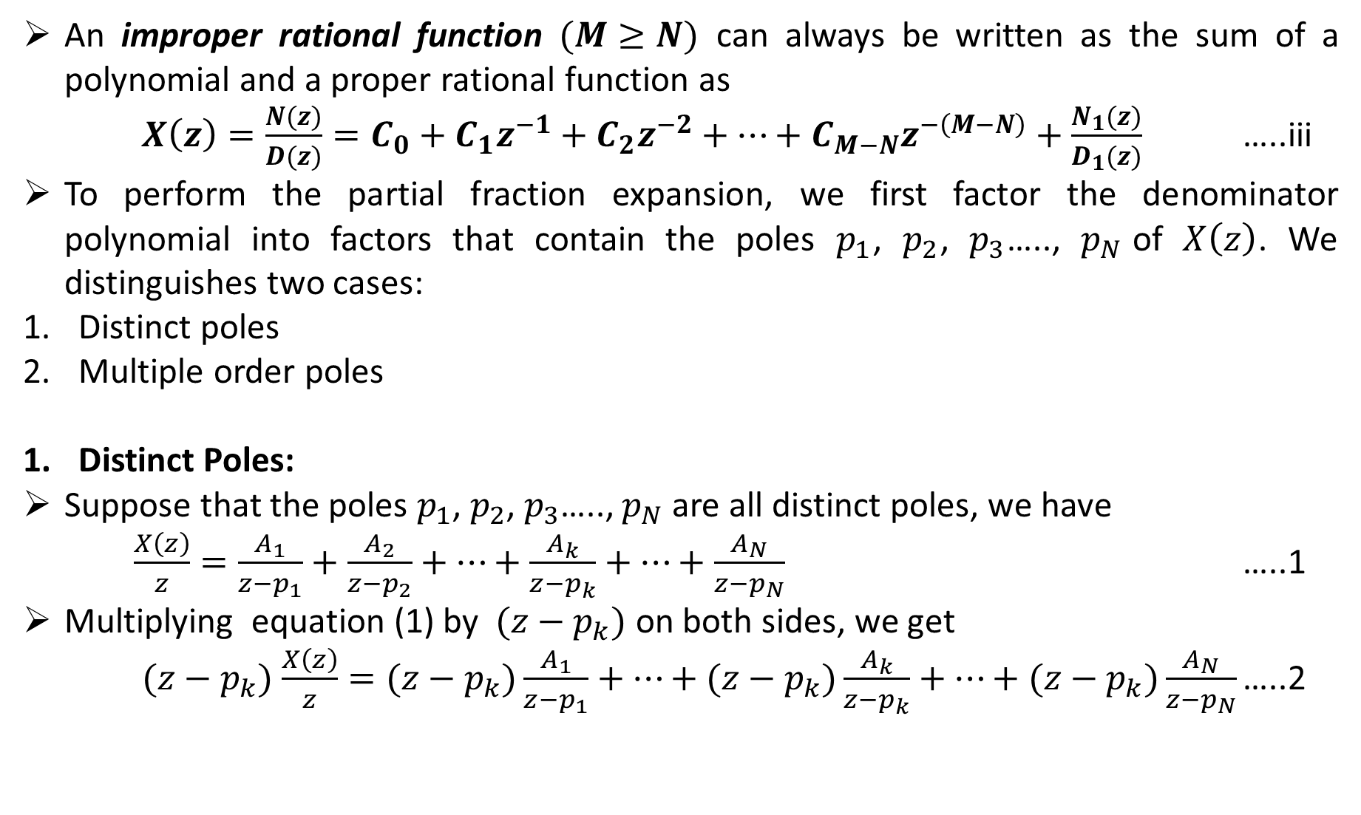
An improper rational function $(M≥N)$ can always be written as the sum of a polynomial and a proper rational function as
$X\left(z\right)=\frac{N(z)}{D(z)}=C_{0}+C_{1}z^{−1}+C_{2}z^{−2}+…+C_{M−N}z^{−\left(M−N\right)}+\frac{N_{1}(z)}{D_{1}(z)}$ …..iii
To perform the partial fraction expansion, we first factor the denominator polynomial into factors that contain the poles $p_{1}$, $p_{2}$, $p_{3}$….., $p_{N}$of $X\left(z\right)$. We distinguishes two cases:
Distinct poles
Multiple order poles
Distinct Poles:
Suppose that the poles $p_{1}$, $p_{2}$, $p_{3}$….., $p_{N}$ are all distinct poles, we have
$\frac{X\left(z\right)}{z}=\frac{A_{1}}{z−p_{1}}+\frac{A_{2}}{z−p_{2}}+…+\frac{A_{k}}{z−p_{k}}+…+\frac{A_{N}}{z−p_{N}}$ …..1
Multiplying equation (1) by $(z−p_{k})$ on both sides, we get
$(z−p_{k})$ $\frac{X\left(z\right)}{z}=(z−p_{k})\frac{A_{1}}{z−p_{1}}+…+(z−p_{k})\frac{A_{k}}{z−p_{k}}+…+(z−p_{k})\frac{A_{N}}{z−p_{N}}$ …..2

Slide 30
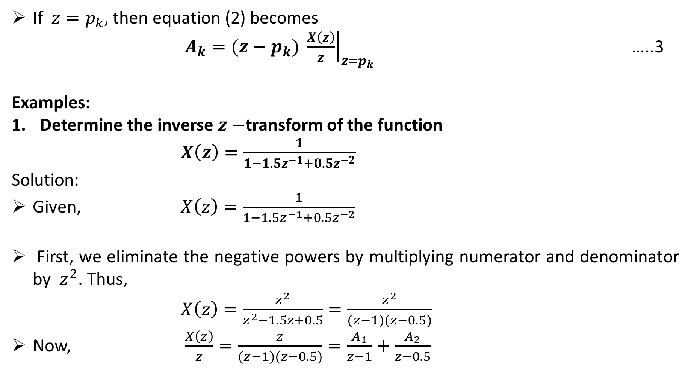
If $z=p_{k},$then equation (2) becomes
$A_{k}={\left.(z−p_{k}) \frac{X\left(z\right)}{z}\right|}_{z=p_{k}}$ …..3
Examples:
Determine the inverse $z−$transform of the function
$X\left(z\right)=\frac{1}{1−1.5z^{−1}+0.5z^{−2}}$
Solution:
Given, $X\left(z\right)=\frac{1}{1−1.5z^{−1}+0.5z^{−2}}$
First, we eliminate the negative powers by multiplying numerator and denominator by $z^{2}$. Thus,
$X\left(z\right)=\frac{z^{2}}{z^{2}−1.5z+0.5}=\frac{z^{2}}{(z−1)(z−0.5)}$
Now, $\frac{X\left(z\right)}{z}=\frac{z}{(z−1)(z−0.5)}=\frac{A_{1}}{z−1}+\frac{A_{2}}{z−0.5}$

Slide 31
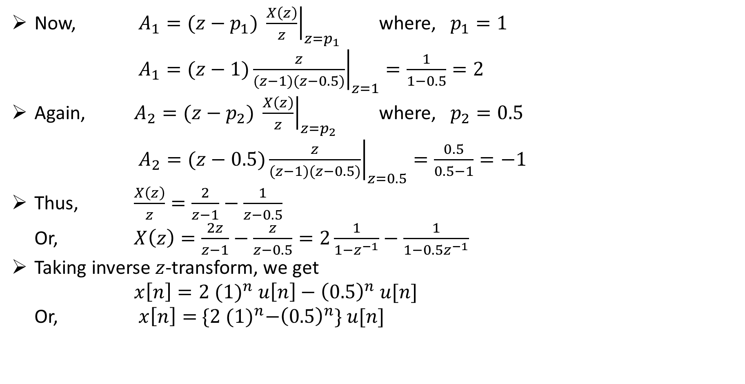
Now, $A_{1}={\left.(z−p_{1}) \frac{X\left(z\right)}{z}\right|}_{z=p_{1}}$ where, $p_{1}=1$
$A_{1}={\left.(z−1)\frac{z}{(z−1)(z−0.5)}\right|}_{z=1}=\frac{1}{1−0.5}=2$
Again, $A_{2}={\left.(z−p_{2}) \frac{X\left(z\right)}{z}\right|}_{z=p_{2}}$ where, $p_{2}=0.5$
$A_{2}={\left.(z−0.5)\frac{z}{(z−1)(z−0.5)}\right|}_{z=0.5}=\frac{0.5}{0.5−1}=−1$
Thus, $\frac{X\left(z\right)}{z}=\frac{2}{z−1}−\frac{1}{z−0.5}$
Or, $X\left(z\right)=\frac{2z}{z−1}−\frac{z}{z−0.5}=2\frac{1}{1−z^{−1}}−\frac{1}{1−0.5z^{−1}}$
Taking inverse $z$-transform, we get
$x\left[n\right]=2 {(1)}^{n} u\left[n\right]−{\left(0.5\right)}^{n} u[n]$
Or, $x\left[n\right]=$ $\{2 {(1)}^{n}−{\left(0.5\right)}^{n}\} u[n]$

Slide 32
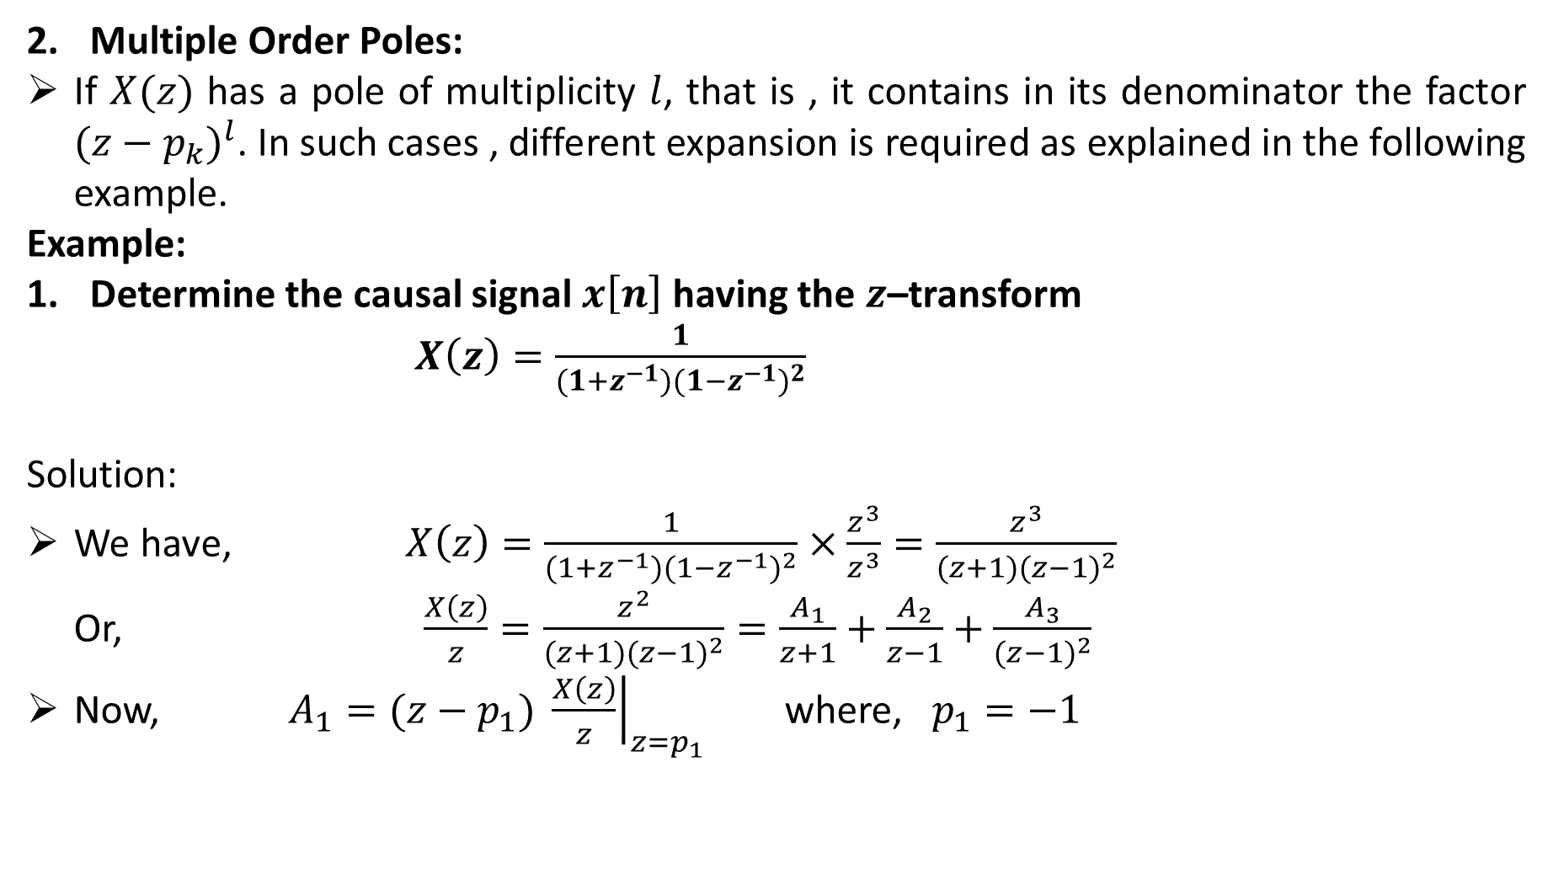
Multiple Order Poles:
If $X(z)$ has a pole of multiplicity $l$, that is , it contains in its denominator the factor ${(z−p_{k})}^{l}$. In such cases , different expansion is required as explained in the following example.
Example:
Determine the causal signal $x\left[n\right]$ having the $z$–transform
$X\left(z\right)=\frac{1}{(1+z^{−1}){(1−z^{−1})}^{2}}$
Solution:
We have, $X\left(z\right)=\frac{1}{(1+z^{−1}){(1−z^{−1})}^{2}}×\frac{z^{3}}{z^{3}}=\frac{z^{3}}{(z+1){(z−1)}^{2}}$
Or, $\frac{X\left(z\right)}{z}=\frac{z^{2}}{(z+1){(z−1)}^{2}}=\frac{A_{1}}{z+1}+\frac{A_{2}}{z−1}+\frac{A_{3}}{{(z−1)}^{2}}$
Now, $A_{1}={\left.(z−p_{1}) \frac{X\left(z\right)}{z}\right|}_{z=p_{1}}$ where, $p_{1}=−1$

Slide 33
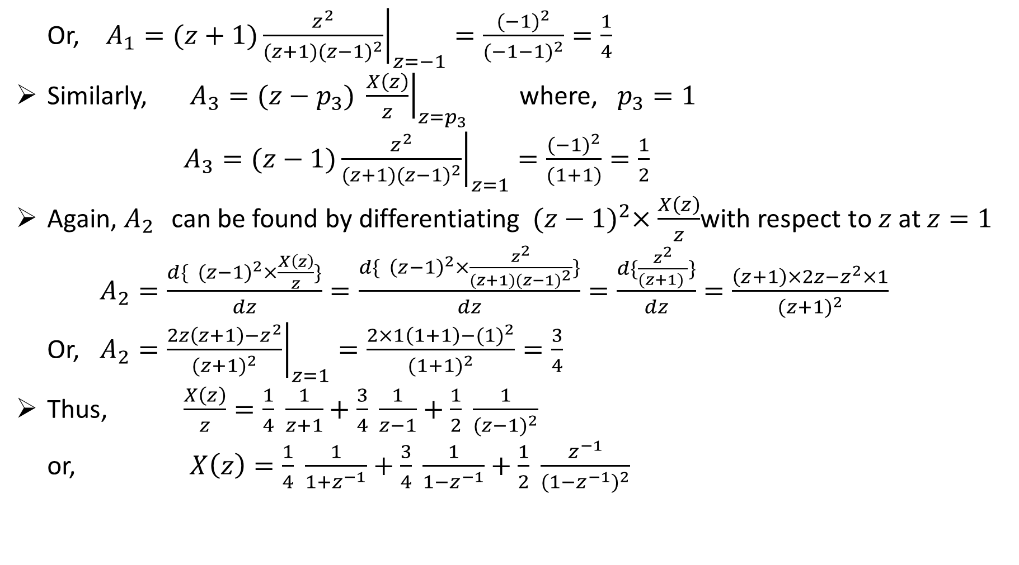
Or, $A_{1}={\left.(z+1)\frac{z^{2}}{(z+1){(z−1)}^{2}}\right|}_{z=−1}=\frac{{(−1)}^{2}}{{(−1−1)}^{2}}=\frac{1}{4}$
Similarly, $A_{3}={\left.(z−p_{3}) \frac{X\left(z\right)}{z}\right|}_{z=p_{3}}$ where, $p_{3}=1$
$A_{3}={\left.(z−1)\frac{z^{2}}{(z+1){(z−1)}^{2}}\right|}_{z=1}=\frac{{(−1)}^{2}}{(1+1)}=\frac{1}{2}$
Again, $A_{2 }$can be found by differentiating${ (z−1)}^{2}×\frac{X\left(z\right)}{z}$with respect to $z$ at $z=1$
$A_{2}=\frac{d\{{ (z−1)}^{2}×\frac{X\left(z\right)}{z}\}}{dz}=\frac{d\{{ \left(z−1\right)}^{2}×\frac{z^{2}}{(z+1){(z−1)}^{2}}\}}{dz}=\frac{d\{\frac{z^{2}}{(z+1) }\}}{dz}=\frac{\left(z+1\right)×2z−z^{2}×1}{{(z+1)}^{2}}$
Or, $A_{2}={\left.\frac{2z\left(z+1\right)−z^{2}}{{(z+1)}^{2}}\right|}_{z=1}=\frac{2×1\left(1+1\right)−{(1)}^{2}}{{(1+1)}^{2}}=\frac{3}{4}$
Thus, $\frac{X\left(z\right)}{z}=\frac{1}{4} \frac{1}{z+1}+\frac{3}{4} \frac{1}{z−1}+\frac{1}{2} \frac{1}{{(z−1)}^{2}}$
or, $X\left(z\right)=\frac{1}{4} \frac{1}{1+z^{−1}}+\frac{3}{4} \frac{1}{1−z^{−1}}+\frac{1}{2} \frac{z^{−1}}{{(1−z^{−1})}^{2}}$

Slide 34

Taking inverse $z$–transform , we get
$x\left[n\right]=\frac{1}{4}{(−1)}^{n} u\left[n\right]+\frac{3}{4}{(1)}^{n} u\left[n\right]+\frac{1}{2}{n(1)}^{n} u\left[n\right]$
$x\left[n\right]=\frac{1}{4}{(−1)}^{n} u\left[n\right]+\frac{3}{4}{(1)}^{n} u\left[n\right]+\frac{1}{2}n u\left[n\right]$

